Slide 1
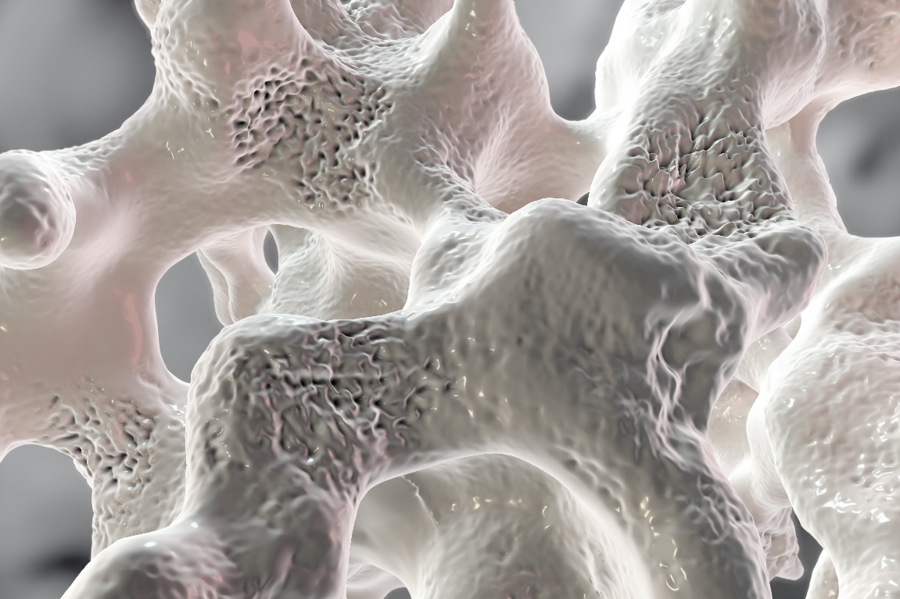
THE CLINICAL EXCHANGE
Expert Perspectives on Treating and Managing Patients
at High Risk for Fracture

Slide 2

Presenter Disclosure
Presenter - [presenter name]
Relationships with commercial interests:
Grants/Research Support:
Speakers Bureau/Honoraria:
Consulting Fees:
Patents:
Other:

Slide 3
Disclosure of Commercial Support
This program has received financial support from Amgen Canada in the form of an educational grant.
This program has received in-kind support from Amgen Canada in the form of logistical support.
Potential for conflict(s) of interest:
[Presenter] has received [payment/funding, etc.] from [organization supporting this program AND/OR organization whose product(s) are being discussed in this program].
Amgen Canada developed, licenses, distributes and benefits from the sale of a product that will be discussed in this program

Slide 4
Mitigating Potential Bias
The Canadian Heart Research Centre (CHRC) and the Canadian Centre for Professional Development in Health and Medicine (CCPDHM) assesses conflict of interest with its instructors, planners, managers and other individuals who are in a position to control the content of CME activities. All relevant conflicts of interest that are identified are thoroughly vetted by the CHRC and CCPDHM for fair balance, scientific objectivity of studies utilized in this program, and patient care recommendations. The CHRC and CCPDHM is committed to providing its learners with high quality CME activities and related materials that promote improvements or quality in healthcare and not a specific proprietary business interest of a commercial interest.
The speaker had provided a full disclosure in advance of the program. The scientific content of the program is evidence based and all content related to pharmacotherapy is within product label. The program has been peer reviewed and is nationally accredited by the College of Family Physicians of Canada.
[Presenter] has provided his disclosure information at the start of this presentation.

Slide 5
Accreditation Statement
This one-credit-per-hour Group Learning program has been certified by the College of Family Physicians of Canada and the Provincial Chapter for up to X Mainpro+ credits.

Slide 6

Program Development
This program was planned by the Canadian Centre for Professional Development in Health and Medicine, a not-for-profit academic organization to achieve scientific integrity, objectivity, and balance.
This program has received an educational grant and in-kind support from Amgen Canada

Slide 7

Learning Objectives
Upon completion of this session, participants will be better able to:
Perform risk assessments and screening for all patients at high risk for stress fracture, including all patients who are treatment naïve or currently on therapy
Translate scientific and clinical evidence into the management and treatment of all high risk patients in primary care practice
Integrate expert recommendations and practical strategies for future assessment, treatment and management of all patients at high risk for stress fracture

Slide 8
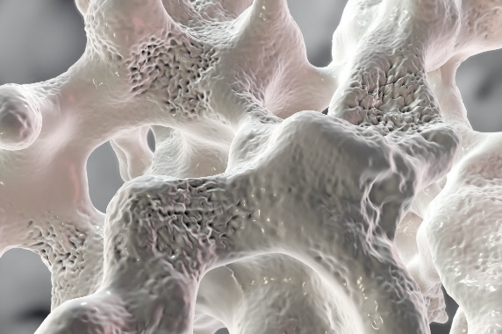

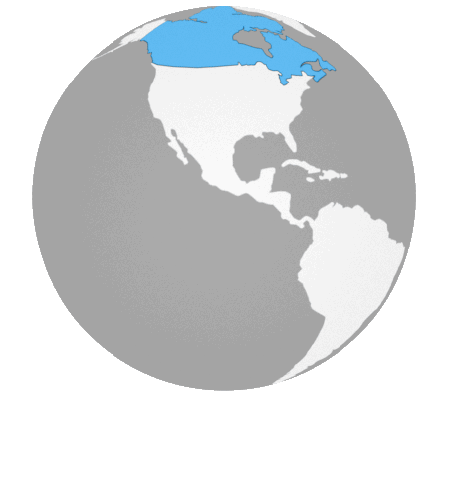
Increased focus on Osteoporosis
Global Perspective
Canadian Perspective

Slide 9
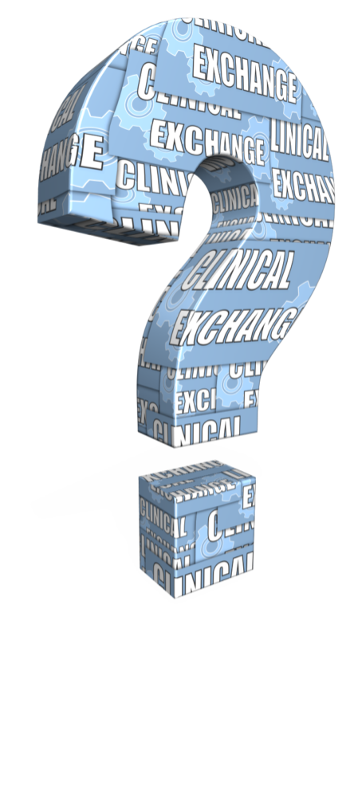
How many Canadians are affected by Osteoporosis?
Select from one of the available options
500,000
950,000
1.2 million
2 million
Notes:
Correct Answer is 4 – at least 2 million Canadians are affected

Slide 10
Approximately how many hip fractures occur in Canada per year?
Select from one of the available options
15,000
22,000
30,000
37,000
Notes:
Correct Answer is 3 – approximately 30,000

Slide 11
A Global Call to Action
The American Society for Bone and Research (ASBMR) issued in 2016 an international call to action to address the “Crisis in the Treatment of Osteoporosis”
The 30 year decline in hip fractures has plateaued and is met with aging population
Post hip fracture mortality rates are up to 24%
Less than half of those who broke a bone were referred for a bone density test or prescribed medication to threat their osteoporosis
The cause of this crisis:
Declining rate of testing, diagnosis and treatment of high risk patients
Leading to increased fractures, disability and loss of independence
Physician Paper. ASBMR 2016. Call to Action to Address the Crisis in the Treatment of Osteoporosis.

Slide 12
A Global Call to Action
To address the crisis the organizations have identified the following calls to action:
Providing health education for HCPs focused on diagnosing and treating patients at high risk for fracture
Engaging health organizations to increase support for high risk patients
Educating insurers effective services to improve diagnosis and treatment of high risk patients
Identifying strategies for health systems to adapt and use quality measures to screen and treat high risk individuals
Physician Paper. ASBMR 2016. Call to Action to Address the Crisis in the Treatment of Osteoporosis.

Slide 13




Global Perspective: Treatment Gap
In review of the gap associated with case finding and management of individuals at high risk for fracture and to ensure delivery of best clinical practice, there are 4 opportunities of systematic case findings for clinicians to focus on:
Case finding and management of individuals at high risk for fracture
Public awareness of osteoporosis and fragility fractures
Reimbursement and health system policy
Epidemiology of fractures in the developing world
Harvey, N.C et al. Mind the (treatment) gap: a global perspective on current and future strategies for prevention of fragility fractures. Osteoporos Int. DOE 10.1007/s00198-016-3894-7. Published online: 07 February 2017.

Slide 14

Global Perspective: Treatment Gap¹
In review of the gap associated with case finding and management of individuals at high risk for fracture and to ensure delivery of best clinical practice, there are 4 opportunities of systematic case findings for clinicians to focus on:
Secondary fracture prevention – “fracture begets a fracture”
Primary fracture prevention – cost-effectiveness of prevention of 1st fracture
1 in 2 women and 1 in 5 men will have a fragility fracture after the age of 50²
OP induced by medicines
Diseases associated with OP
.
1. Harvey, N.C et al. Mind the (treatment) gap: a global perspective on current and future strategies for prevention of fragility fractures. Osteoporos Int. DOE 10.1007/s00198-016-3894-7. Published online: 07 February 2017.
2. van Staa TP, Dennison EM, Leufkens HG, Cooper C (2001) Epidemiology of fractures in England and Wales. Bone 29:517– 522.

Slide 15
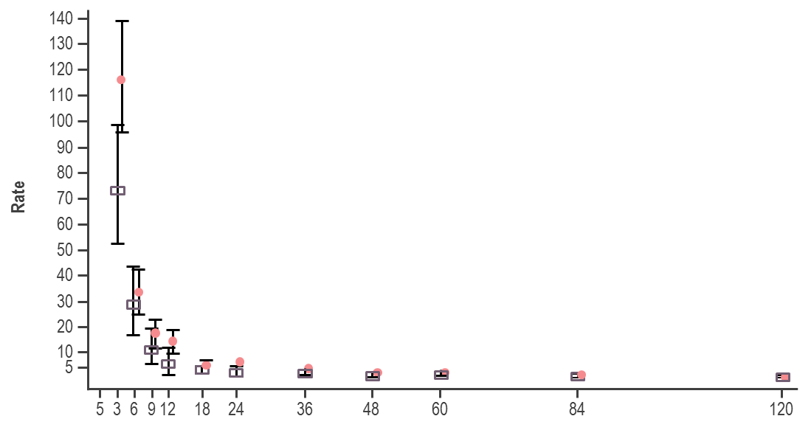
Risk Of Sustaining A Second Hip Fracture is High During First 12 Months Following First Hip Fracture
Incident hip fractures in residents of Funen
County, Denmark, from 1994 through 2004
Months
Period estimates of incidence of second hip fracture for men (square) and women (circle) by time from first fracture. Values are poisson regression-based estimates and 95% CI of rate per 1000 person years (py).
.
Nymark, T., et al. Osteoporos Int. 2006;17:1353-1357.
Notes:
Months after 1st fracture

Slide 16
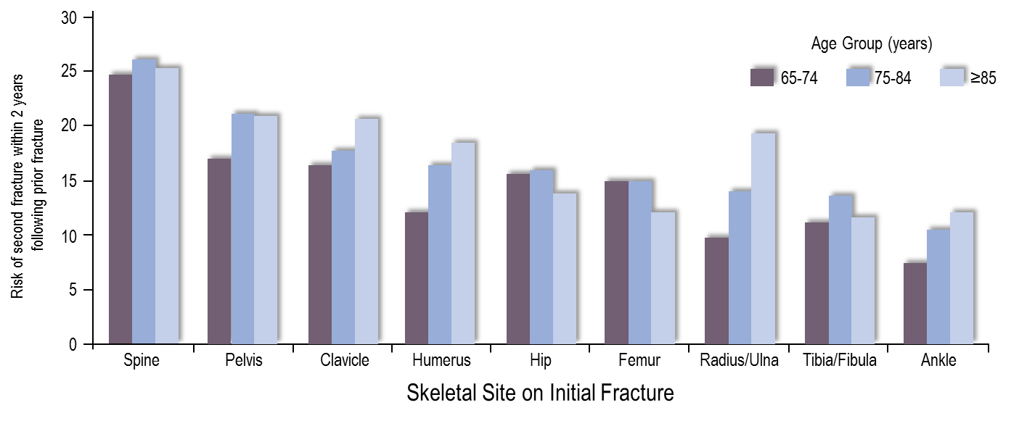
Secondary Fracture: Risk in the Near Term (2 years) is High
After initial fracture (spine, hip, pelvis, femur, or clavicle) women were at up to 25% risk of second fracture at 2 years, regardless of patient age
Among women with a clinical fracture, 17.9% fractured again within 2-years following the initial fracture and 4.8 % sustained a hip fracture
.
*The outcome is a composite of closed clinical fractures at any skeletal site other than the skull/face/fingers/toes in the inpatient setting and/or requiring surgical intervention.
Adapted from Balasubramanian A, et al. Presented at: ASBMR annual meeting; October 16-18, 2016; Atlanta, GA. Abstract FR0233.

Slide 17
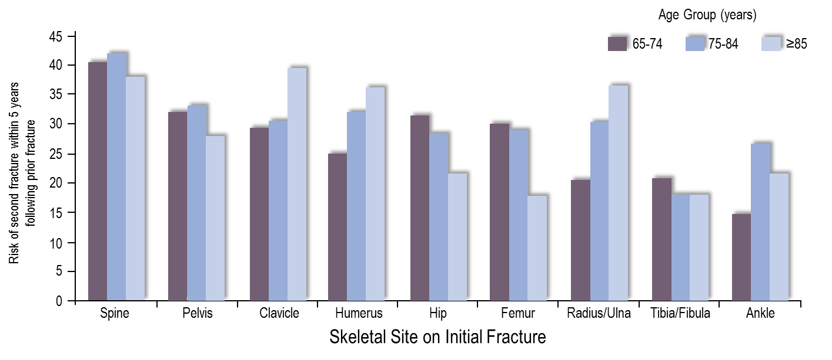
Secondary Fracture: Risk in the Near Term (5 years) is High
Among women with a clinical fracture, 30.9% fractured again within 5-years following the initial fracture and 10.2 % sustained a hip fracture
.
*The outcome is a composite of closed clinical fractures at any skeletal site other than the skull/face/fingers/toes in the inpatient setting and/or requiring surgical intervention.
Adapted from Balasubramanian A, et al. Presented at: ASBMR annual meeting; October 16-18, 2016; Atlanta, GA. Abstract FR0233.

Slide 18
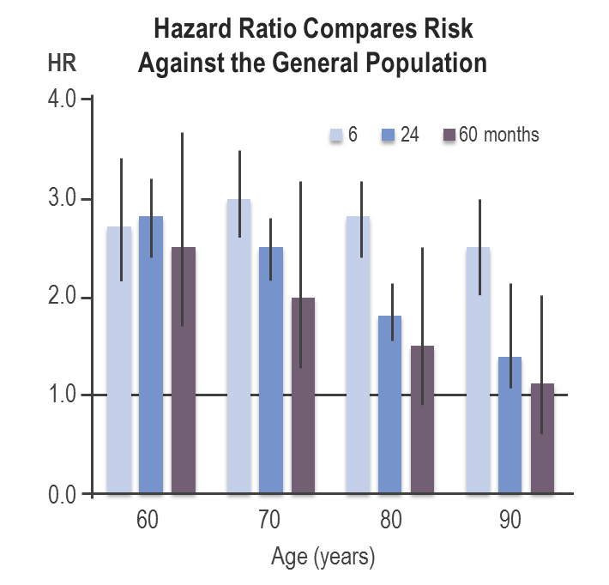
Imminent Risk of Major OP Fracture
Imminent risk increases with age¹
Imminent risk increases with a recent or prior fracture
Risk of subsequent fracture increase with recent or prior fracture certain cites*^{2,3}
+/- One or more of the following:
Older age (≥ 65 years)²⁻⁵
Low BMD^{3,5}
Fall risk factors including comorbidities and certain medications^{3,5}
*Recent fracture is fracture within the past 12 months. Prior fracture is any history of fracture at spine, hip, pelvis, femur, clavicle, humerus, tibia/fibila, radius/ulna.
.
1. Johansson H, et al. Osteoporos Int. 2017;28(3): 775–780. 2. Balasubramanian A, et al. Presented at: ASBMR annual meeting; October 16-18, 2016; Atlanta, GA. Abstract FR0233. 3. Yusuf AA, et al. Presented at: ASBMR annual meeting; October 16-18, 2016; Atlanta, GA. Abstract MO0223. 4. Ahmed LA, et al. J Bone Miner Res. 2013;28:2214-2221.5. Yusuf AA, et al. Presented at: ASBMR annual meeting; October 16-18, 2016; Atlanta, GA. Abstract SU0227.

Slide 19
In Patients at Imminent Risk, Absolute Cumulative Fracture Risk Remains Elevated Over Time
Cumulative Risk of Subsequent Fracture
Increasing absolute cumulative risk
Imminent risk
Cumulative risk of subsequent fracture
Follow-up (years)
.
Analysis of a large Medicare sample of women ≥ 65 years old with an incident clinical fracture.
Balasubramanian A, et al. Presented at: ASBMR annual meeting; October 16-18, 2016; Atlanta, GA.

Slide 20
The Economic Burden of Fractures in Canada is Growing
2008 Data
2011 Data
Change
(%)
M; Millions
B; Billions
Acute care
$1.3B
18%
$1.5B
Rehabilitation admissions & clinics†
$106M
234%
$353M
Complex Continuing Care
$123M
253%
$434M
Long-term Care
$31M
3,245%
$1.0B
Home care
$266M
3%
$274M
Outpatient physician services
$155M
TOTAL BURDEN OF ILLNESS
63%
$253M
Prescription drugs
$426M
2008:
$2,518,598,262
-19%
$346M
2011:
$4,619,665,079
Wage loss
$126M
143%
$305M
Change (%): 83%
Mobility devices‡
$101M
N/A
0
0.5B
1.0B
1.5B
.
†2008 data not included for Rehabilitation clinics.
‡2008 Data not included for mobility devices.
Tarride, J.E., et al. Osteoporos Int. 2012;23:2591-2600.; Hopkins, R.B., et al. Osteoporos Int.2016; DOI: 10.1007/s00198-016-3631-6.

Slide 21
The Effect of Osteoporosis Treatment on Mortality
30-70%
REDUCTION
Effective medications reduce subsequent fractures by
30% to 70% as early as one year after treatment initiation¹
Fragility fractures cause substantial morbidity and mortality, effective osteoporosis treatment prevents both vertebral and nonvertebral fractures²
40,000 SUBJECTS
Meta-analysis in ~40,000 subjects showed that treatment of osteoporosis with agents with proven vertebral and nonvertebral fracture efficacy reduces overall mortality by ~10%²
.
1. Papaioannou, A., et al. CMAJ. 2010;182(17):1864‐1873.
2. Bolland, M.J., et al. J Clin Endocrinol Metab. 2010;95:1174-1181.

Slide 22
Women >50 and Osteoporosis¹
1 in 3 women will suffer from an osteoporotic fracture during their lifetime¹
Over 80% of all fractures in Canada after age 50 are osteoporotic¹
Osteoporotic fracture incidence in women over 50 years of age¹
22% of women over 50 experience a wrist fracture
27% experience a vertebral fracture
15% experience a hip fracture
7% experience a pelvis fracture
29% experience other fractures including clavicle, humerus, femur, tibia/fibia, and hands/fingers
Almost 50% of fractures occur at the spine or hip and are associated with significant morbidity and mortality.²⁻⁶
1. Burge R, et al. J Bone Miner Res. 2007;22:465-475; 2. Watts NB, et al. Endocr Pract. 2010;16:1-37. 3. Hajcsar EE, et al. CMAJ. 2000;163:819-822.;
4. Cooper C. Am J Med. 1997:103:12S-19S; 5. Jean et al . JBMR. 2013; 28:360-71. 6. Papaioannou A, et al. CMAJ. 2010;182:1864-1873.

Slide 23
Men and Osteoporosis
1 in 5 men will suffer from an osteoporotic fracture during their lifetime
>25% of all hip fractures occur in men¹
Lifetime risk of experiencing an osteoporotic fracture in men over the age of 50 is 30%², similar to the lifetime risk of developing prostate cancer³
Men have the SAME risk factors for fracture as women
By age 65, men catch up to women and lose bone mass at the same rate⁴
It is estimated that by 2025, the total number of hip fractures in men will be similar to the current number reported in women⁵
Compared to women, men who fracture a hip have an increased risk of mortality, and more comorbid diseases, despite their younger age at the time of fracture⁶
Fracture risk increases with:⁷
Parental history of fracture (especially hip)
Systemic glucocorticoid use (≥3 months)†
Rheumatoid arthritis, or other secondary causes of osteoporosis
Men generally have higher rates of fracture related mortality – 37% of men who suffer a hip fracture will die within the year following that fractured hip.^{1,8}
†≥3 months in the prior year of a prednisone equivalent dose ≥ 7.5mg daily.
1. Osteoporosis Canada 2016; 2. Melton LJ, 3rd, et al. J Bone Miner Res. 1992; 7:1005; 3. Hasserius R, et al. Osteoporos Int. 2003;14:61; 4.IOF 2017; 5. Seeman E. Am J Med. 1995; 98:76S–88S; 6. Gruber-Baldini et al. J Am Geriatr Soc. 2017;65(3):e64-e69; 7. Papaioannou, A., et al. CMAJ. 2010; 182:1864-1873. 8. Adachi JD, et al. Osteoporos Int. 2001;12:903.
Notes:
Speaker Notes:
2025 data: Seeman E. The dilemma of osteoporosis in men. Am J Med. 1995; 98:76S–88S
References 5, 6, 6, 7, 8-10 in Gruber-Baldini

Slide 24
High Imminent Vertebral Fracture Risk with COPD AND Previous Vertebral Fracture
Incidence of Vertebral Fractures
by baseline vertebral fracture (y/n)
Incidence of Vertebral Fractures
by number of vertebral fracture at baseline
100
100
**
80
80
HR 4.2
(3.2-5.6)
HR 3.6
(2.9-4.6)
60
60
**
HR 3.1
(2.3-4.2)
Subjects (%) with incident VFs
Subjects (%) with incident VFs
HR 5.1
(3.6-7.4)
HR 6.7
(4.4-10.1)
40
40
HR 3.9
(2.4-6.2)
VFs at baseline:
20
VFs at baseline:
20
No VFs
No
1 VF
Yes
≥ VF
0
One year
Three year
0
**p for trend <0.001
One year
Three year
Incidence of vertebral fractures (VFs) and adjusted hazard ratios within 1 and within 3 years.
ECLIPSE (Evaluation of COPD Longitudinally to Identify Predictive Surrogate Endpoints) study is a non-interventional,observational, multicenter study searching for underlying mechanisms of disease progression in conjunction with COPD.
van Dort, M.J., et al. J Bone Mineral Res. 2018. In press.
Notes:
Speaker Notes

Slide 25
Several Factors Contribute to Long-Term Fracture Risk
Prior fracture¹⁻⁵
Recent fracture
Any history of fracture
Female sex
Asian or white ethnicity
Family history of hip fracture or osteoporosis
Small frame
Certain comorbid conditions (e.g., RA, COPD, Parkinson’s)
Age⁵
Risk Factors for Future Fracture
Low BMD⁵
Low BMI
Calcium/vitamin D deficiency
Estrogen deficiency
Inadequate physical activity
Excessive alcohol intake
Tobacco smoking
Frequent falling and other fall-related risk factors
Use of certain medications (e.g., glucocorticoids)
Other genetic / nonmodifiable risk factors^{5,6}
Other potentially modifiable risk factors⁵
BMD=bone mineral density; BMI=body mass index; COPD=chronic obstructive pulmonary disease; RA=rheumatoid arthritis
1. Kanis JA, et al. Bone. 2004;35:375-382. 2. Kanis JA, et al. Lancet. 2002;359:1929-1936. 3. Black DM, et al. J Bone Miner Res. 1999;14:821-828. 4. Eisman JA, et al. J Bone Miner Res. 2012;27:2039-2046. 5. Cosman F, et al. Osteoporos Int. 2014;25:2359-2381. 6. US Department of Health and Human Services. Bone health and osteoporosis: a report of the surgeon general. 2004. Rockville, MD.

Slide 26
Fragility Fracture Increases Risk of Hip Fracture
Morbidity
Hip fracture
Excess morbidity associated with fracture event
Fragility fractures: wrist
humerus, pelvis, vertebrae
Wrist fracture
Morbidity attributable to ageing alone
50
60
70
80
90
Age
Adapted from: Kanis, J.A., & Johnell, O. J Endocrinol Invest. 1999;22(8):583-8.
Notes:
Key Point:
Wrist fractures are usually the first fragility fracture, with vertebral fractures occurring next.
Preventative Therapy Is Effective and Safe.
Reference:
Kanis JA, Johnell O. The burden of osteoporosis. J Endocrinol Invest. 1999;22(8):583-8.

Slide 27
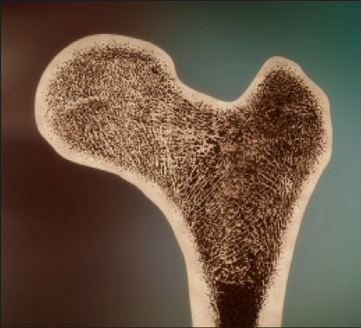
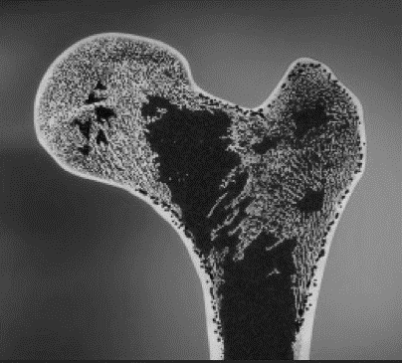
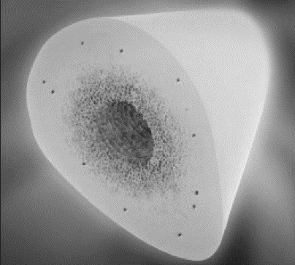
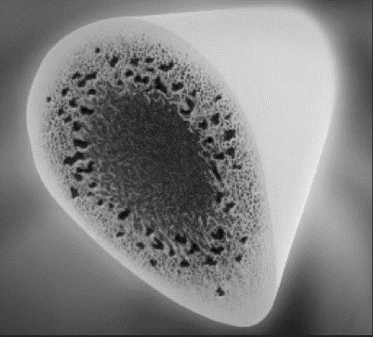
AGE: The Impact of Aging and Osteoporosis on Bone
Young
Elderly/OP
Trabecular thickness decreases with age
Cortical porosity increases with age
The result is a decrease in bone strength
Davison, S.K., et al. Semin Arthritis Rheum. 2006;36:22-31.; Mosekilde, L. Technol Health Care. 1998;6:287-297.; Seeman, E., et al. J Bone Miner Res. 2010;25:1886-1894. Image courtesy of David Dempster.
Notes:
Key Point:
Decreases in bone volume has a nonlinear effect on bone strength; extremely low bone volumes (< 15% bone/volume) leads to a large drop in mechanical strength of the bone.¹
Trabecular thickness decreases with aging,² resulting in decreased bone strength (which is proportional to the square of its radius), which ultimately leads to buckling and bending of the trabecular struts.¹
Connectivity is significantly impacted with the loss of each cross tie, since each one leaves two trabecular struts unsupported.¹
Cortical porosity increases with aging, leading to disproportionately large losses in bone strength.¹
In older adults (> 60 years), the pores increase in size through coalescing to reduce the actual number of pores.¹
Microarchitectural changes in the vertebral body have been shown to occur with aging, including decreased bone volume per trabecular volume (BV/TV) and decreased cortical thickness.²
Davison SK, Siminoski K, Adachi JD, et al. Bone strength: the whole is greater than the sum of its parts. Semin Arthritis Rheum. 2006;36:22-31.
Mosekilde L. The effect of modelling and remodelling on human vertebral body architecture. Technol Health Care. 1998;6:287-297.

Slide 28
When to do a BMD¹ In Women and Men
Aged ≥ 65 years | Aged 50-64 years | Aged <50 years
Everyone | One or more risk factors for fracture: Fragility fracture after age 40 Parental hip fracture Vertebral fracture or osteopenia identified on radiography Medication with high risk of bone loss (i.e. steroids) Smoking, alcohol (≥3/d) Disorders associated with osteoporosis (i.e. RA) Low weight or major weight loss | 2°causes of osteoporosis (i.e. malabsorption) Prior fragility fracture Medication with high risk of bone loss
Clinical Note:
If you are ordering unrelated imaging (e.g. chest x-ray) for your patient, consider adding “rule out vertebral fracture” on the order²
1. Papaioannou, A., et al. CMAJ. 2010;182:1864-1873.; 2. Steering Group Communications Feb 9th 2012.
Notes:
Key Point:
Indications for measuring Bone Mineral Density (BMD):
Aged ≥65 years
Everyone
Aged 50-64 years
Clinical risk factors for fracture (menopausal women, men age 50-64 years)
Fragility fracture after age 40 yr
Prolonged use of glucocorticoids (at least 3 months cumulative therapy in the previous year at a prednisone-equivalent dose ≥7.5mg daily)
Use of other high-risk medications (ie. aromatase inhibitors for breast cancer or androgen deprivation therapy for prostate cancer)
Parental hip fracture
Vertebral fracture or osteopenia identified on radiography
Current smoking
High alcohol intake (≥3 units/day)
Low body weight (<60kg) or major weight loss (>10% of body weight at age 25 yr)
Rheumatoid arthritis
Other disorders strongly associated with osteoporosis include: primary hyperparathyroidism, type 1 diabetes, osteogenesis imperfecta, uncontrolled hyperthyroidism, hypogonadism or premature menopause (< 45 years, ), Cushing’s disease, chronic malnutrition or malabsorption, chronic liver disease, COPD and chronic inflammatory conditions (e.g. Inflammatory bowel disease)
Aged <50 years
Fragility fracture
Prolonged use of glucocorticoids (at least 3 months cumulative therapy in the previous year at a prednisone-equivalent dose ≥7.5mg daily)
Use of other high-risk medications (ie. aromatase inhibitors for breast cancer or androgen deprivation therapy for prostate cancer)
Hypogonadism or premature menopause (age <45 yr)
Malabsorption syndrome
Primary hyperthyroidism
Other disorders strongly associated with rapid bone loss and/or fracture
Perform additional biochemical testing to rule out secondary causes of osteoporosis in selected patients.
Reference:
1. Papaioannou A, et al CMAJ 2010;182:1864-1873. 2. Steering Group Communications Feb 9th 2012.

Slide 29
BMD Alone is Not an Indicator of Fracture Risk BMD vs. Osteoporotic Fracture Rates/Number
60
BMD distribution
450
Fracture Rate
400
50
No of Fractures
350
40
300
250
30
No. of Fractures
Fracture rate per 1000 person-years
200
20
150
100
10
50
0
0
>1.0
1.0
to 0.5
0.5
to 0.0
0.0
to –0.5
–0.5
to –1.0
–1.0
to –1.5
–1.5
to –2.0
–2.0
to –2.5
–2.5
to –3.0
–3.0
to –3.5
< –3.5
BMD T-scores
Adapted from: Siris, E.S., et al. JAMA. 2001;286:2815-22.
Notes:
Key Point:
BMD alone is not an indication of fracture risk.
Fracture rates are higher in those with low T-scores.
Population BMD demonstrates that a higher proportion of the population has a BMD in the middle range (-2.0 to -0.5)
Fracture rate shows that there is higher rate of fracture in those with OP or a T-score <-2.5, however the number of fractures shows that most fractures occur at T-scores of -2.5 to -0.5.
Data demonstrates that BMD alone cannot be used to assess fracture risk.

Slide 30
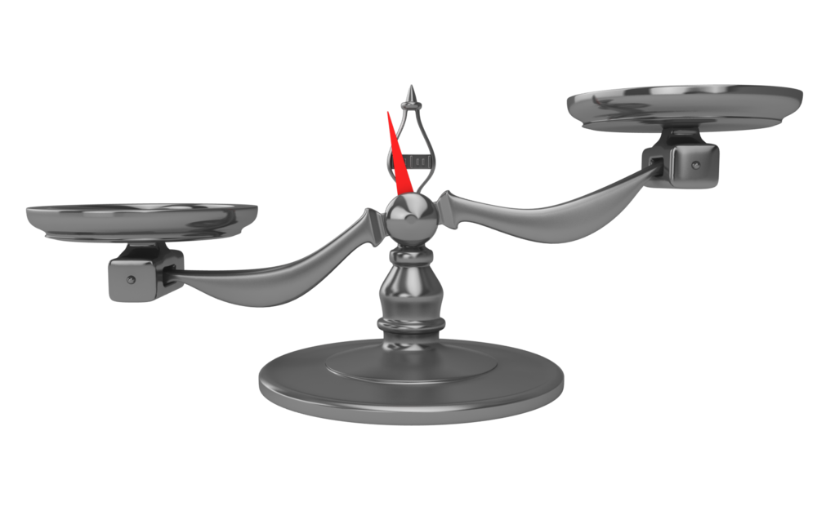
Relationship between BMD and Fracture Risk is Strongly Dependent on Clinical Risk Factors
BMD
CLINICAL RISK FACTORS
Fracture Risk
Bates, D.W., et al. JAMA. 2002;288(15):1898-1900.; Geusens, P., et al. (2011). Medscape. Accessed June 30, 2016 at www.medscape.org/viewarticle/747951_2.
Notes:
Key Point:
http://www.medscape.org/viewarticle/747951_2

Slide 31
Additional Factors for Fracture Risk
Age, Sex
Fragility Fracture after age 40
Fall History ≥2 Times in past year
Medications
Comorbidities
Alcohol Intake ≥3 drinks per day
Caffeine Intake
Nutrition (balanced diet with adequate Ca2+ and vit D)
Physical Activity or Inactivity
Hormonal Status
Ethnicity: Caucasian, Asian and Hispanics have a higher fracture risk
Low testosterone is associated with a higher risk of vertebral, nonvertebral and hip fractures
Cauley, J.A. Clin Orthop Relat Res. 2011;469(7):1891–1899.
Svejme, O., et al. BJOG. 2012;119(7):810-6.; Mellstrom, D., et al. J Bone Miner Res. 2008;23(10):1552-60.; Meier, C., et al. Arch Intern Med. 2008; 168(1):47-54.
Notes:
Key Point:
Mellstrom D, et al. Older men with low serum estradiol and high serum SHBG have an increased risk of fractures. J Bone Miner Res. 2008 Oct;23(10):1552-60.
Meier C, et al. Endogenous sex hormones and incident fracture risk in older men: the Dubbo Osteoporosis Epidemiology Study. Arch Intern Med. 2008;168(1):47-54.

Slide 32
Frequent Falling is Associated with Serious Injury and a Greater Risk of Fracture
Women with osteoporosis and without a fall*
Fracture risk: 2.8 (95% CI, 0.6-12.8; P<.10)
Women with osteoporosis and a fall*
Fracture risk: 24.8 (95% CI, 6.9-88.6; P<.0001)
*Compared with women without osteoporosis and without a fall, fracture risk age- and BMI-adjusted.
Nevitt, M.C., et al. J Gerontol Med Sci. 1991;46(5):M164-70.; Geusens, P., et al. Arch Phys Med Rehabil. 2002; 83(7):903-6.
Notes:
Key Point:

Slide 33
High Alcohol Consumption Decreases Bone Remodelling and Increases Fracture Risk
Consuming > 4 units of alcohol/day can double the risk of hip fracture
Heavy alcohol consumption is associated with:
Decreased BMD
Impaired bone quality
Increased fracture risk
Increased risk of falls
Likely due to a decrease in bone remodelling
Kanis, J.A., et al. Osteoporos Int. 2005;16:737-42.; Gaddini, G.W., et al. Alcohol Clin Exp Res. 2016;40(4):657-71.
Notes:
Key Point:

Slide 34
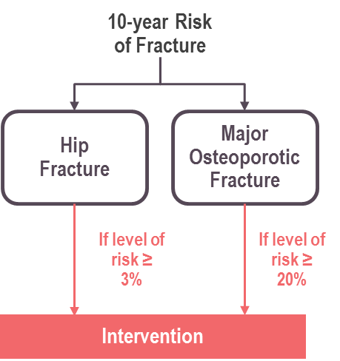
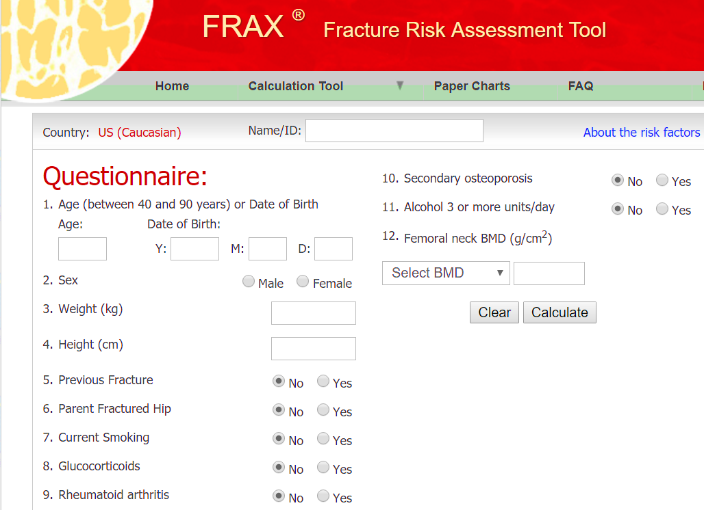
Long-Term Fracture Risk Can Be Quantified Using FRAX® or Other Risk-Assessment Tools
FRAX® provides conservative estimate of 10-year fracture risk but does not necessarily identify patients with shorter-term risk who require urgent intervention (pharmacological) to prevent subsequent fractures¹⁻³
Input¹
Calculator¹
Output¹
Age
Gender
BMD
Fracture History
Other Characteristics
Smoking
Alcohol use
Rheumatoid arthritis
Glucocorticoids use
Etc
FRAX® is a registered trademark of Professor J.A. Kanis. University of Sheffield.
BMD=bone mineral density; FRAX=fracture risk assessment tool.
1. FRAX. https://www.shef.ac.uk/FRAX/. Accessed March 15, 2018. 2. Kanis JA, et al. Osteoporos Int. 2011;22:2395-2411. 3. Silverman SL, et al. Curr Osteoporos Rep. 2010;8:192-197
Notes:
Key Point:

Slide 35
OC Guideline Recommendations
 | Antiresorptive Therapy |  |  |  | Bone Formation Therapy
 | Bisphosphonates |  |  | Denosumab | Teriparatide
 | Oral Branded | Oral Generic | IV
OC Guideline Recommendations
Vertebral | ✓ | ✓ | ✓ | ✓ | ✓
Hip | ✓ | ✓ | ✓ | ✓ | -
Non-vertebral† | ✓ | ✓ | ✓ | ✓ | ✓
OC Guideline Recommendations for Long-Term Care Patients
High Risk* | ✓ | ✓ | ✓ | ✓ | Suggested treatment
High Risk with dysphagia* |  |  | ✓ | ✓ | Suggested treatment
High Risk with CrCl <30 mL/min |  |  |  | ✓†
†Clinical monitoring of serum calcium levels is recommended because of higher risk of hypocalcemia; consider referral to specialist.
Adapted from: Papaioannou, A., et al. CMAJ. 2015;187(15):1135-1144.

Slide 36
TREATMENT &
MANAGEMENT

Slide 37
BMD Responses to Antiresorptive Therapy at 3 years in Pivotal Clinical Trials
vs. Placebo from Baseline | Antiresorptive Therapy
 | Bisphosphonates |  |  |  | Denosumab (FREEDOM)⁵
 | Alendronate (FIT 1)¹ | Risedronate Daily (VERT-MN)² | Risedronate Weekly³ | Zoledronic Acid (HORIZON)⁴
Change in Lumbar Spine BMD | 6.2% | 5.9% | 5.2% at 24 months | 6.7% | 8.8%
Change in femoral neck | 4.1% | 2.4% | N/A | 5.1% | 5.2%
1. Reginster, J., et al. Osteoporos Int. 2000;11(1):83-91 (VERT-MN); 2. Black, D.M., et al. Lancet. 1996;348:1535-1541 (FIT 1); 3. Actonel/Actonel DR (risedronate sodium) Product Monograph. Sanofi-Aventis Canada Inc. Laval, QC. July 15, 2011; 4. Black, D.M., et al. N Engl J Med. 2007;356:1809-1822. (HORIZON); 5. Cummings, S.R., et al. N Eng J Med. 2009;361:756-765 (FREEDOM).

Slide 38
Risedronate Reduces Vertebral, Non-vertebral, and Hip Fractures
Cochrane Meta-Analysis: Patients’ incidence of fracture and weighted relative risk for fractures after treatment with 5 mg risedronate
n= 3066
RRR 37%
Placebo
Risedronate 5 mg
RRR 20%
n= 12 397
Percentage of patients with fractures (%)
RRR 26%
n= 11 786
RR 0.63 (95% CI, 0.51–0.77)
p<0.0001
RR 0.80 (95% CI, 0.72–0.90)
p=0.0002
RR 0.74 (95% CI, 0.59–0.94)
p=0.01
Wells, G.A., et al. Cochrane Database Syst Rev. 2008;23(1):CD004523.
Notes:
Speaker Notes
This slide shows the results of a Cochrane meta-analysis of fracture outcomes in women receiving at least 1 year of risedronate for PMO, compared with those receiving placebo or concurrent calcium/vitamin D or both. The outcome was fracture incidence.¹
The authors concluded that at 5 mg/day, a statistically significant and clinically important benefit in the secondary prevention of vertebral*, non-vertebral and hip fractures occurred, but not for wrist fractures.¹
The authors concluded that there were no statistically significant reductions in the primary prevention of vertebral and non-vertebral fractures.¹
* Studies included morphometric vertebral fracture data.
Vertebral fractures:
ARR is 4.59% (NNT = 22)⁺
Non-vertebral fractures:
ARR is 1.53% (NNT = 66)⁺
Hip fractures:
ARR is 1.04% (NNT = 96)⁺
+ Calculated based on data from Cochrane analysis.¹
Reference:
Wells GA, Cranney A, Peterson J, et al. Risedronate for the primary and secondary prevention of osteoporotic fractures in postmenopausal women. Cochrane Database Syst Rev. 2008;Jan23;(1):CD004523.

Slide 39
Denosumab Reduces Vertebral, Non-vertebral, and Hip Fractures in Women With PMO
RCT: FREEDOM 3-year Pivotal Fracture Trial in PMO women
RRR 20%
RRR 68%
8.0%
n= 84/3875
Placebo
Denosumab
7.2%
n= 264/3691
6.5%
n= 19/3861
Fracture incidence at month 36 (%)
RRR 40%
2.3%
n= 82/3702
1.2%
n= 388/3875
0.7%
n= 292/2861
*
†
RR 0.32 (95% CI, 0.26–0.41) p<0.001 vs placebo
RR 0.80 (95% CI, 0.67–0.95) p=0.01 vs placebo
RR 0.60 (95% CI, 0.37–0.97) p=0.04 vs placebo
*Crude incidence; †Kaplan-Meier estimate of incidence.
Cummings, S.R., et al. N Eng J Med. 2009;361:756-765.
Notes:
Speaker Notes
FREEDOM (Fracture REduction Evaluation of Denosumab in Osteoporosis Every 6 Months) is the pivotal fracture trial for denosumab. It is a randomized, double-blind, placebo-controlled multicentre, phase 3 study involving women with PMO.
A total of 7,868 women with a mean age of 72.3 years were recruited from 214 clinical centres in 32 countries.¹
Women aged 60 to 90 years with a lumbar spine or total hip T-score < −2.5 and ≥ −4.0 were randomly assigned to receive 60 mg of denosumab subcutaneously, or matching placebo, every 6 months for 3 years.¹
All participants received at least 1000 mg/day of elemental calcium and at least 400 to 800 IU/day of vitamin D.¹
The primary outcome measure was the risk of new vertebral fractures while secondary outcomes included the risk of non-vertebral fractures and hip fractures.
At baseline, mean femoral neck T-score -2.15 (denosumab) and -2.17 (placebo), and 23% had baseline vertebral fractures.¹
Compared with placebo, denosumab reduced the risk of new radiographic vertebral fractures, with a cumulative incidence of 2.3% in the denosumab group, versus 7.2% in the placebo group (risk ratio, 0.32; 95% CI, 0.26 to 0.41; p<0.001)—a relative decrease of 68%.¹
Compared to placebo, denosumab reduced the risk of clinical vertebral fractures by 69% (95% CI, 53 to 80%); p<0.001.¹
New vertebral fracture – ARR = 4.8; NNT=21
Non-vertebral fracture ARR = 1.5; NNT=68
Hip fracture ARR = 0.3%; NNT=205
Reference:
Cummings SR, San Martin J, McClung MR, et al. Denosumab for prevention of fractures in postmenopausal women with osteoporosis. N Eng J Med. 2009;361:756-765.

Slide 40
Teriparatide Reduces Risk of Vertebral and Non-vertebral Fractures in Women With PMO
RCT: Effect of daily PTH for 18 months on vertebral and non-vertebral fractures
14%
n= 64/448
Placebo
PTH 20 mcg
RRR 65%
Percentage of patients with ≥1 fracture in 2 years (%)
5%
n= 22/444
5.5%
n= 30/544
RRR 53%
2.6%
n= 14/541
*
RR 0.35 (95% CI, 0.22–0.55)
p<0.001 vs placebo
RR 0.47 (95% CI, 0.25–0.88)
p=0.02 vs placebo
*Includes hip fracture
Neer, R.M., et al. N Engl J Med. 2001;344:1434-1441.
Notes:
Speaker Notes
This trial assigned 1637 postmenopausal women with prior vertebral fractures to receive 20 or 40 μg of teriparatide (PTH [1-34]) or placebo, administered subcutaneously by the women daily.¹
The study was terminated early by the sponsor to evaluate the clinical relevance of pre-clinical osteosarcoma findings. Patients were treated for a mean of 18±5 months for placebo, 18±6 months for 20 mcg and 17±6 months for 40 mcg.
New vertebral fractures (morphometric) occurred in 14% of women in the placebo group and in 5% and 4%, respectively, of women in the 20 µg and 40 µg groups.¹
The respective relative risks of fracture in the 20 µg and 40 µg groups as compared with the placebo group were 0.35 and 0.31 (95% CI, 0.22 to 0.55 and 0.19 to 0.50).¹
New non-vertebral fragility fractures (including hip) occurred in 5.5% of women in the placebo group and in 2.6% of those in each teriparatide group (relative risk, 0.47 and 0.46, respectively [95% CI, 0.25 to 0.88 and 0.25 to 0.86]).
Total hip fractures in study: 9 of 1637 patients (not significant for with each treatment group).¹
Vertebral fractures:
ARR is 6% (NNT = 11)¹
Non-vertebral fractures:
ARR is 3% (NNT = 33)¹
Reference:
Neer RM, Arnaud CD, Zanchetta JR, et al. Effect of parathyroid hormone (1-34) on fractures and bone mineral density in postmenopausal women with osteoporosis. N Engl J Med. 2001;344:1434-1441.

Slide 41
Comparison Studies of Denosumab vs Bisphosphonates in Bisphosphonate Pretreated
Subjects: Total Hip BMD at 12 months
4
1.1%^{b}
3
1.6%ª
0.9%
DMAb
a
1.4%ª
DMAb
DMAb
DMAb
Percentage change in total hip BMD
from baseline
2
IBN
ALN
1
ZOL
RIS
0
0.5%
2.0%
1.1%
2.3%
1.1%
1.9%
0.6%
1.9%
Data are least-squares means and 95% confidence intervals. ªp < 0.0001; ^{b}p < 0.001.
ALN, alendronate; BMD, bone mineral density; DMAb, denosumab; IBN, ibandronate; RIS, risedronate; ZOL, zoledronic acid.
Recknor, C., et al. Obstet Gynecol. 2013;121:1291-9; Kendler, D.L., et al. J Bone Miner Res. 2010;25(1):72-81.; Roux, C., et al. Bone. 2014;58:48-54.; Miller, P.D., et al. (2015). ACR.
Notes:
Speaker Notes
DMAb demonstrated significantly greater BMD gains at month 12 compared with ZOL at all skeletal sites measured

Slide 42
Fracture Incidence Decreases Significantly with OP Therapy Initiation in Real World Setting
Clinical vertebral fractures reduced over 12 months in PMO
*Denosumab (51%; 95% CI 42 – 59%)
Zoledronic acid (25%; 95% CI 17 – 32%)
Oral bisphosphonates (23%; 95% CI 20 – 26%)
Teriparatide (64%; 95% CI 58 – 69%)
Any Fracture
15
3-month early treatment period
Subsequent 12-month on-treatment period
10
Fracture incidence per 100 patient-years
5
0
Denosumab
Zoledronic Acid
Bisphosphonates
Raloxfine
Teriparatide
*Relative to first 3 months after initiation.
Yusuf, A.A., et al. Arch Osteoporos. 2018;13(1):33.
Notes:
Speaker Notes

Slide 43
Male: ADAMO Continued BMD Increases With 24-Month of Denosumab Treatment at Lumbar Spine
Double-blind
Open-label
8.0†
8
Continued denosumab (n=111)
Cross-over denosumab (n=117) Placebo comparator for months 0-6
5.8*
6
5.7†
4.3*
Mean percentage change from baseline (95% CI)
4
2
0.9*
0.8*
0
0
0
6
12
18
24
Study Month
*p < 0.05 vs double-blind baseline. †p < 0.0001 vs double-blind and open-label baseline. CI = confidence interval.
Adapted from: Langdahl, B.L., et al. J Clin Endocrin Metab. 2015;100(4):1335-134. doi:10.1210/jc.2014-4079
Notes:
OBJECTIVE:
The purpose of this study was to evaluate denosumab therapy in men with low bone mineral density (BMD).
DESIGN:
This was a phase 3 study with 2 treatment periods: a previously reported 12-month double-blind, placebo-controlled phase and a 12-month open-label phase.
SETTING:
This was a multicenter study conducted in North America and Europe.
PARTICIPANTS:
A total of 228 men entered the open-label phase and 219 completed the study.
INTERVENTION:
Men from the original denosumab (long-term) and placebo (crossover) groups received 60 mg of denosumab sc every 6 months.
MAIN OUTCOME MEASURES:
BMD, serum collagen type I C-telopeptide, and safety were measured.
RESULTS:
During the open-label phase, continued BMD increases occurred with long-term denosumab treatment (2.2% lumbar spine, 0.9% total hip, 1.3% femoral neck, 1.3% trochanter, and 0.2% 1/3 radius), resulting in cumulative 24-month gains from baseline of 8.0%, 3.4%, 3.4%, 4.6%, and 0.7%, respectively (all P < .01). The crossover group showed BMD gains after 12 months of denosumab treatment similar to those of the long-term denosumab group during the first treatment year. Significant reductions in serum collagen type I C-teleopeptide were observed after denosumab administration. Adverse event rates were similar between groups, and no new safety signals were identified.
CONCLUSIONS:
In men with low BMD, denosumab treatment for a second year continued to increase BMD, maintained reductions in bone resorption, and was well tolerated. BMD increased in men initiating denosumab during the second year. These effects were similar to those previously seen in postmenopausal women with osteoporosis and in men with prostate cancer receiving androgen deprivation therapy.

Slide 44
Male: Continued BMD Increases with Denosumab at 24 Months: Total Hip, Femoral Neck, Trochanter, 1/3 Radius
Continued denosumab
Cross-over denosumab
Placebo
Total Hip
Femoral Neck
4
3.4†
4
3.4†
3
2.3*
3
2.2*
2
1.6*
2
1.7*
1
0.3
2.0†
1
1.8†
0.1
0.0
–0.1
0
0
–1
–1
Mean percentage change from baseline (95% CI)
0
6
12
18
24
0
6
12
18
24
Trochanter
1/3 Radius
5
4.6†
2
4
3.2*
3
1.8*
1
0.6*
0.7*
2
0.8*
2.7†
0.1
0.6‡
1
0.2
0
0
–0.3
–0.3
–1
–1
0
6
12
18
24
0
6
12
18
24
Study Month
Study Month
Data are least square means.*p < 0.05 vs double-blind baseline; †p < 0.0001 vs double-blind and open-label baseline; ‡p < 0.05 vs double-blind and open-label baseline.
Adapted from: Langdahl, B.L., et al. J Clin Endocrin Metab. 2015;100(4):1335-134. DOI:10.1210/jc.2014-4079
Notes:
OBJECTIVE:
The purpose of this study was to evaluate denosumab therapy in men with low bone mineral density (BMD).
DESIGN:
This was a phase 3 study with 2 treatment periods: a previously reported 12-month double-blind, placebo-controlled phase and a 12-month open-label phase.
SETTING:
This was a multicenter study conducted in North America and Europe.
PARTICIPANTS:
A total of 228 men entered the open-label phase and 219 completed the study.
INTERVENTION:
Men from the original denosumab (long-term) and placebo (crossover) groups received 60 mg of denosumab sc every 6 months.
MAIN OUTCOME MEASURES:
BMD, serum collagen type I C-telopeptide, and safety were measured.
RESULTS:
During the open-label phase, continued BMD increases occurred with long-term denosumab treatment (2.2% lumbar spine, 0.9% total hip, 1.3% femoral neck, 1.3% trochanter, and 0.2% 1/3 radius), resulting in cumulative 24-month gains from baseline of 8.0%, 3.4%, 3.4%, 4.6%, and 0.7%, respectively (all P < .01). The crossover group showed BMD gains after 12 months of denosumab treatment similar to those of the long-term denosumab group during the first treatment year. Significant reductions in serum collagen type I C-teleopeptide were observed after denosumab administration. Adverse event rates were similar between groups, and no new safety signals were identified.
CONCLUSIONS:
In men with low BMD, denosumab treatment for a second year continued to increase BMD, maintained reductions in bone resorption, and was well tolerated. BMD increased in men initiating denosumab during the second year. These effects were similar to those previously seen in postmenopausal women with osteoporosis and in men with prostate cancer receiving androgen deprivation therapy.

Slide 45
Male: BMD Responses to
Bisphosphonate Therapy with 24-Month Treatment
from Baseline | Antiresorptive Therapy
 | Bisphosphonates
 | Alendronate¹* | Risedronate Weekly² | Zoledronic Acid³
Change in Lumbar Spine BMD | 5.3% | 4.5% | 6.1%
Change in femoral neck | 2.6%
* vs. placebo; † vs. weekly alendronate
1. Orwoll, E., et al. N Engl J Med. 2000;343:604-10.; 2. Boonen, S., et al. J Bone Miner Res. 2009;24(4):719-25.; 3. Orwoll, E.S., et al. J Bone Miner Res. 2010;25:2239–2250.

Slide 46
Teriparatide: BMD Increases in Male OP
Mean Percent Change in BMD from Baseline to Endpoint in Men with Primary Hypogonodal OP Treated for a Median of 10 months
 | Teriparatide (N=151) | Placebo (N=147)
Lumbar spine BMD | 5.9† | 0.5
Femoral Neck BMD | 1.5‡ | 0.3
Total Hip BMD | 1.2 | 0.5
Trochanter BMD | 1.3 | 1.1
Distal 1/3 radius BMD | -0.5 | -0.2
†p<0.001 compared with placebo; ‡p<0.05 compared with placebo.
Forteo-Drug Label Information. DailyMed. February 10, 2015. Accessed on June 1, 2016 at https://dailymed.nlm.nih.gov/dailymed/drugInfo.cfm?setid=aae667c5-381f-4f92-93df-2ed6158d07b0.
Notes:
http://www.ncbi.nlm.nih.gov/pubmedhealth/PMH0041227
Forteo-Drug Label Information. DailyMed. February 10, 2015.
[Accessed on June 1, 2016 https://dailymed.nlm.nih.gov/dailymed/drugInfo.cfm?setid=aae667c5-381f-4f92-93df-2ed6158d07b0]

Slide 47
Comorbidities Significantly Contribute to Fracture Risk
Global Longitudinal Study of Osteoporosis in Women (GLOW)
Co-morbidities that contributed most to fracture prediction*:
Parkinson's disease
Multiple sclerosis
COPD
Osteoarthritis
Heart disease
Increasing co-morbidity index† associated with increasing fracture risk
*in a Cox regression model with FRAX risk factors as additional predictors.
†weighted value for each co-morbidity based on parameter estimates from the Cox regression model.
COPD: chronic obstructive pulmonary disease.
Dennison, E.M., et al. Bone. 2012;50(6):1288-93.
Notes:
Key Point:

Slide 48
Comorbidities Significantly Contribute to Fracture Risk
The Osteporotic Fracture in Men Study (MrOS)
Co-morbidities that contributed hip fracture risk:
Use of tricyclic antidepressants
Heart disease/ myocardial infarction or angina
Hyperthyroidism
Parkinson's disease
Increasing number of risk factors associated with increasing fracture risk
Cauley, J.A., et al. J Bone Miner Res. 2016;31(10):1810-1819.
Notes:
Key Point:

Slide 49
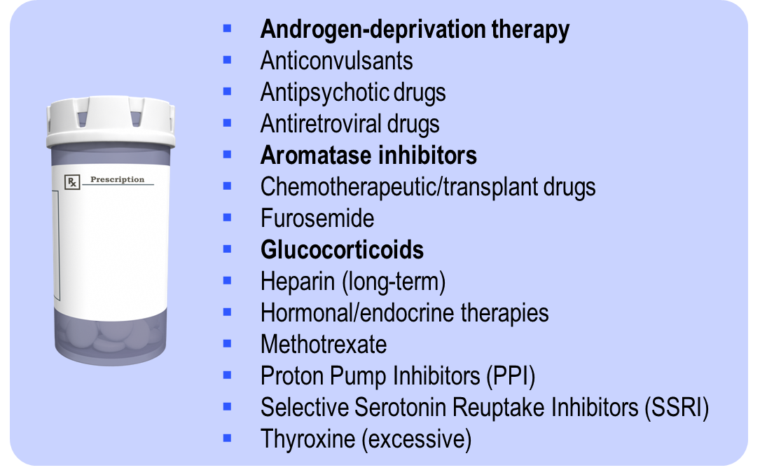
Medications that May Cause or Accelerate Bone Loss
Hodgson, S.F., Watts, N.B., et al. Endocr Pract. 2003;9:544-564.; Jacobs-Kosmin, D. (2011). Medscape CME. Accessed May 25th 2011. http://emedicine.medscape.com/article/330598-overview
Notes:
Key Notes:
Chemotherapeutic/transplant drugs (i.e. cyclosporine, tacrolimus, platinum compounds, cyclophosphamide)
Commonly Used Medications Recently Suggested to Have a Potential Association With Increased Fracture Risk
Proton-pump inhibitors (PPIs)
-Increased risk of hip fracture observed after long-term, high dose therapy³
Selective-serotonin reuptake inhibitors (SSRIs)
2-fold increased risk of clinical fragility fracture observed with daily use⁴
Thiazolidinediones (TZDs)
In postmenopausal women with type 2 diabetes, a significantly increased risk of peripheral fracture was observed with rosiglitazone than with metformin or glyburide⁵
References:
Hodgson SF, Watts NB, et al. American Association of Clinical Endocrinologists medical guidelines for clinical practice for the prevention and treatment of postmenopausal osteoporosis: 2001 edition, with selected updates for 2003. Endocr Pract. 2003;9:544-564.
Jacobs-Kosmin D. Osteoporosis. Medscape CME. 2011. Accessed May 25th 2011. http://emedicine.medscape.com/article/330598-overview
Yang YX, Lewis JD, Epstein S, Metz DC. Long-term Proton Pump Inhibitor Therapy and Risk of Hip Fracture. JAMA. 2006;296:2947-2953.
4. Richards JB, Papaioannou A, Adachi JD, et al. Effect of Selective Serotonin Reuptake Inhibitors on the Risk of Fracture. Arch Intern Med. 2007;167:188-194.
5. Kahn SE, Zinman B, Lachin JM, et al. Rosiglitazone-Associated Fractures in Type 2 Diabetes: An analysis from A Diabetes Outcome Progression Trial (ADOPT). Diabetes Care. 2008;31:845-851.

Slide 50
BENEFITS OF TREATMENT PERSISTENCE &
adherence

Slide 51
PMO Patients on Therapy
Approximately 13% of patients fracture while on antiresorptive therapy¹
Fracturing while on therapy does not necessarily mean that treatment is ineffective
In clinical trials, fracture rates are reduced by 25-60% depending on the type of therapy and the skeletal site of the fracture
1. Drug Intelligence. Osteoporosis Chart Audit, November 2011 (unpublished).
Notes:
Key Points:
According to an independent chart audit done by Drug Intelligence, ~13% of patients on antiresorptive therapy report fracturing while on treatment (82/610)¹
In this chart audit, treatment included all products – oral BPs, Aclasta, Evista, Forteo, Prolia¹
Fracturing while on therapy does not necessarily mean that treatment is ineffective; however, in those that do fracture while on therapy, assess whether a change in therapy is appropriate
There is also no evidence-based reason to withold OP therapy during fracture healing²
Continued therapy and reassessment should address secondary prevention²
References:
Drug Intelligence, Osteoporosis Chart Audit, November 2011 (unpublished).
Goldhahn J, Little D, Mitchell P, et al. Evidence for anti-osteoporosis therapy in acute fracture situations – recommendations of a multidisciplinary workshop of the International Society for Fracture Repair. Bone 2010;46:267-271.

Slide 52
Adherence Encompasses Both Persistence and Compliance
Reflects a combination of behaviours determining the extent to which patients take medications as prescribed.
Adherence
Persistence
+
Compliance
The length of time from beginning to completion or discontinuation of therapy
The consistency and accuracy with which a prescribed regimen is followed
Payer J, et al. Biomed Pharmacother. 2007;61:191-193.
Notes:
Key Point
Adherence is a combination of both persistence and compliance.
Supplemental Information
Therapeutic adherence is defined as the extent to which patients take medications as prescribed, and it is measured both quantitatively and qualitatively¹.
The quantitative portion of adherence is measured by persistence, which defines the length of time on therapy¹.
The qualitative portion of adherence is measured by compliance, which defines the consistency and accuracy with which a prescribed regimen is followed².
Despite poor adherence being a widespread problem in clinical practice, it is poorly defined in the literature and is often incorrectly interchanged with persistence and compliance².
Adherence: the combination of persistence and compliance
Persistence: the duration of time from initiation to discontinuation of therapy
Compliance: taking the medication as prescribed (proper dose, proper time, proper frequency)
References:
Payer J, et al. Biomed Pharmacother 2007;61:191-193.
Gold DT, et al. Ann Pharmacother 2006;40:1143-1150.

Slide 53
Why Persistence is Important?
*Persistence is the duration of time from initiation to discontinuation of therapy
Persistence is strongly associated with clinical outcomes
Decreased persistence to medications contributes to:
Inadequate response to or failure of treatment
Worsening and progression of the disease
Symptom recurrence
“Drugs don’t work in patients who don’t take [receive] them.”
C. Everett Koop, MD, Surgeon General
ISPOR Task Force 2008; Burrell A, et al. Value Health 2005;8:A194-195; Koncz T, et al. Expert Opin Biol Ther. 2010;10(9):1367-1378;
Boonen S, et al. J Clin Endocrinol Metab. 2011; 96(6):1727–1736.

Slide 54
In Order for Medication to Be Effective, Persistence Is Essential
Lack of fracture protection¹
Reduction in 24-month Fracture Risk in Patients Defined as PERSISTENT
(No Gap > 30 Days)¹
12
11
 | Refill gap ≤ 30 days |  | Refill gap > 30 days
n (%) | 7,164 (20%) |  | 28,373 (80%)
All fractures | – 29%† |  | Reference
Vertebral | – 40%† |  | Reference
Nonvertebral | – 29%† |  | Reference
Hip | – 45%† |  | Reference
Wrist | – 23%‡ |  | Reference
Fracture risk is similar to not taking medication at all
10
Probability of fracture at
24 months (%)
9
8
7
10
20
30
40
50
60
70
80
90
100
Percentage of Prescriptions Not Filled (1-MPR)*
Discontinuing OP therapy, regardless of the reason, will result in a gradual decline in pharmacological benefit and increased fracture risk^{2,3}
†P < 0.001 ‡P < 0.02
*MPR (medication possession ratio) measures refill compliance- the percentage of time a medication was available.
Based on a study of 35,537 patients from two claims databases
1. Adapted from Siris ES, et al. Mayo Clin Proc. 2006;81:1013-1022. 2. Papaioannou A, et al. CMAJ. 2010;182:1864-1873; 3. Brown JP, et al. Can Fam Physician. 2014;60:324-333.
Notes:
Key Points¹:
This graph makes the overall point that fracture risk is not reduced unless a minimum compliance rate of 50% is achieved; the curve shows a pronounced fracture reduction at a refill compliance of 75%; it appears that as adherence drops below 50%, fracture protection is virtually the same as not being on medication at all.
Findings are based on a U.S. analysis of two claims databases of 35,537 patients > 45 years who received alendronate or risedronate from 1999 to 2003, evaluated for 6 months before the prescription and 24 months of follow-up.
Endpoints included total, vertebral, and nonvertebral osteoporotic fractures, persistence (no refill gaps > 30 days during follow-up), and refill compliance (monthly prescribing reference > 80%).
57% of patients were noncompliant and 80% of patients were non-persistent.
All three fracture types were significantly lower in compliant and persistent patients.
These results need to be confirmed with a prospective controlled trial.
Comparisons in fracture risk reduction between compliant vs noncompliant patients and between persistent and nonpersistent patients controlled for differences in baseline characteristics between the groups.
Reference:
Siris ES, Harris ST, Rosen CJ, et al. Adherence to bisphosphonate therapy and fracture rates in osteoporotic women: relationship to vertebral and nonvertebral fractures from 2 US claims databases. Mayo Clin Proc. 2006;81:1013-1022.

Slide 55
Impact of Gastrointestinal Problems on Patient Persistence
The MUSIC-OS Study:
A multi-objective prospective observational international study survey in 2,959 treated PMO patients
Survey administered at baseline, 3, 6 and 12 months after enrolment to measure incidence and prevalence of GI problems, associations between GI problems and medication adherence, discontinuation or switching, quality of life, treatment satisfaction and healthcare resource utilization
69% of PMO women on treatment had GI symptoms …
And this was associated with lower adherence, poorer quality of life decreased patient satisfaction (ADIOS, EQ 5D, O PSAT – Q)
†ADEOS measure of adherence; EQ-5D measure of QoL; OPSAT-Q measures treatment satisfaction.
PMO: post-menopausal osteoporosis, BP: bisphosphonate
Adachi J, et al. ECTS. 2014; PP303.
Notes:
Key Points:
Post-menopausal osteoporotic women currently on treatment completed surveys intended to measure the incidence and prevalence of GI problems; the associations between GI problems and medication adherence, discontinuation or switching; the impact of GI problems on quality of life, treatment satisfaction and healthcare resource utilization; and to estimate the proportion of participants with inadequately controlled osteoporosis.
Results
Patients with GI problems reported lower medication adherence than those without GI problems, with ADEOS scores of 18.6 and 19.1 respectively (R20 indicates adherence).
Patients with GI problems also reported lower quality of life than those without GI problems, with EQ-5D summary scores of 71 and 77.3 respectively (score of 100 indicating the highest quality of life).
Patients with GI problems reported lower treatment satisfaction than those without GI problems, with OPSAT-Q scores of 78.6 and 84.6 respectively (score of 100 indicating highest treatment satisfaction).
Two-thirds of patients with fractures in the past three months utilized the emergency room, indicating high healthcare resource use.
Reference:
Adachi J, et al. Gastrointestinal issues and osteoporosis treatment: the medication use patterns, treatment satisfaction, and inadequate control of osteoporosis study (MUSIC-OS). ECTS. 2014;PP303.

Slide 56
Patient Retention (Evaluated in Canadian Population): National data 2012-2017¹
Comparison of Retention Rates for antiresorptive therapy: oral bisphosphonates (risedronate, alendronate 70mg) , etidronate with calcium kit and denosumab) ^{1*†}
Risedronate
Alendronate & Vit-D
Actonel DR
Etidronate plus calcium kit
100%
Alendronate
Denosumab
Alendronate 70 MG
80%
60%
Retention Rate† (%)
40%
20%
0%
New Patients
16-30 Days
61-90 Days
121-150 Days
181-210 Days
241-270 Days
301-330 Days
361-390 Days
421-450 Days
481-510 Days
541-570 Days
601-630 Days
661-690 Days
721-750 Days
781-810 Days
841-870 Days
901-930 Days
961-990 Days
1021-1050 Days
1081-1110 Days
1141-1170 Days
1201-1230 Days
1261-1290 Days
1321-1350 Days
1381-1410 Days
Slower decline in patient retention rate is observed with denosumab at 48 months following initiation compared with oral bisphosphates.^{1*†}
Adapted from QuintilesIMS longitudinal database, November 2012 to June 2017.
*Comparative clinical significance is unknown
†Patient retention rate was evaluated in 60,167 Canadian patients that initiated denosumab or an oral bisphosphate drug from November 2012 to April 2013 and still active in the database 48 months later. Retention rate at 48 months was defined as the percent of selected patients that remained on therapy for 48 months following treatment initiation. Significance was determined using the chi-squared test: denosumab vs. individual oral bisphosphonate, p<0.051.
1. QuintilesIMS longitudinal database. November 2012 to June 2017. Prolia® Product Monograph Amgen Canada Inc. February 13, 2018.

Slide 57
There is a Gap Between Physician’s Perception and Actual Patient Adherence
Physician’s Perception of Patient Adherence¹
Physician perception
Claims-based (actual)
Actual Oral BP Use In Canada:²
>35% of patients do not persist with oral BP therapy after 1 year of treatment
For median treatment period of 5 years, actual median cumulative exposure was only 2.2 years
In 5 years or more of follow-up, approximately 10% of patients filled only a single prescription
100
22%
40%
75
Percentage of adherent patients
**
50
*
25
0
Weekly Oral Bisphosphonates
Monthly Oral Bisphosphonates
Physician perception vs. Weighted claims-based differs significantly with: *p-value <0.05, **p-value <0.01
Adapted from: Copher, R., et al. CMRO. 2010;26:777-85.
Burden, A.M., et al. Osteoporos Int. 2012;23:1075-82.
Notes:
Key Points:
Study involved written questionnaires from prescribers treating patients with postmenopausal osteoporosis (PMO) comparing the questionnaire responses to pharmacy claims of these prescribers’ patients’ refill patterns¹
Approximately 2000 physicians from a large US health plan were faxed or mailed a survey; 412 responded
Data from the physician survey were merged with administrative claims data of the participating physicians’ patients¹
Key Findings¹:
There is a significant difference between the physician’s perception of adherence and the claims-based data on adherence as shown in this figure¹
Physicians believe that the greatest barriers to nonadherence in their patients are side effects and affordability
Main reasons for staying on medications include: fear of fracture, belief that therapy is working, involvement of patients in their treatment decisions
To examine differences across medication class, a weighted proportion of patient adherence was calculated that ensured physicians were accounted for equally, such that physicians with more patients were not valued more than physicians with fewer patients
Additional information on adherence:
Burden AM et al. used Ontario Drug Benefit pharmacy claims to identify residents aged ≥ 66 years who initiated oral bisphosphonate therapy between April 1996 and March 2009²
The study examined bisphosphonate prescribing, persistence and cumulative exposure among seniors in Ontario, Canada
The main findings of this study were:
Persistence with therapy declined from 63% at 1 year to 46% at 2 years and 12% at 9 years
Among those with at least 5 years of follow-up (n = 213,029), 61% had one or more extended gaps in bisphosphonate therapy
Overall, 10% of patients filled only a single prescription, 37% switched to a different bisphosphonate and the median exposure was 2.2 yrs
Less than 25% of patients adhere to their therapy for more than 1 year³
Factors affecting adherence^{4,5} include side effects, safety concerns, health problems, lack of results, lack of motivation, cost, inconvenient dosing or it’s withdrawn by others
Reference:
Copher R, Buzinec P, Zarotsky V, et al. Physician perception of patient adherence compared to patient adherence of osteoporosis medications from pharmacy claims. CMRO 2010; 26: 777-85.
Burden AM, Paterson JM, Solomon DH, et al. Bisphosphonate prescribing, persistence and cumulative exposure in Ontario, Canada. Osteoporos Int 2012;23:1075-82.
McCombs JS, Thiebaud P, McLaughlin-Miley C, et al. Compliance with drug therapies for the treatment and prevention of osteoporosis. Maturitas 2004;48:271-287.
Rossini M, Bianchi G, Di Munno O, et al. Determinants of adherence to osteoporosis treatment in clinical practice. Osteoporos Int 2006;17:914-921.
Payer J, Killinger Z, Sulkova I, et al. Therapeutic adherence to bisphosphonates. Biomed Pharmacother 2007;61:191-193.

Slide 58
Osteoporosis is a Chronic Disease Requiring Life-long Strategies to Reduce Fracture Risk
Oral BP: up to 10 years of treatment maintains the degree of fracture risk reduction observed in the 3-year registration trials
Increasing but low risk of fractures with atypical features with increasing duration of BP therapy
After 5 yrs risk of these atypical fractures is about 20 per 100,000 patients, increases to about 1/1,000 patients after 8-10 yrs of treatment
Denosumab: 10 years of therapy appears to provide fracture risk reduction similar to or better than that observed in the 3-year registration trial
Antifracture benefits of long-term therapy with BPs and denosumab in appropriately selected patients outweigh the low risk of serious side effects
Hanley DA, Writing Group for the Western Osteoporosis Alliance. Am J Med. 2017;130(7):862.

Slide 59
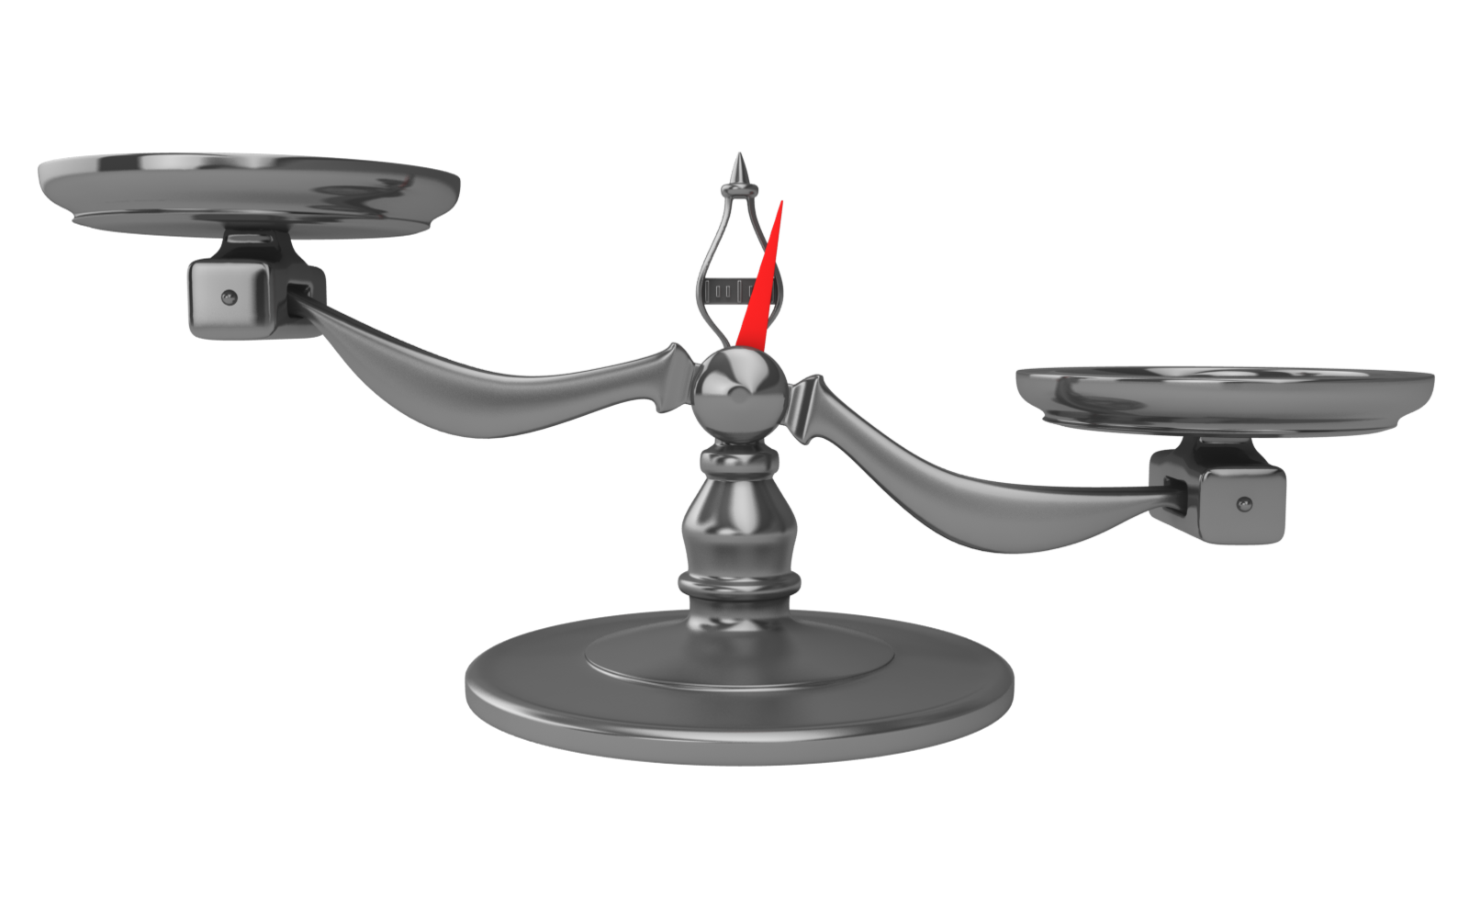
Weighing the Benefits of OP Therapy
BENEFIT
Reduces vertebral fracture risk by
30-70%¹
RISK
Risk of ONJ from BP use: 1.03*
Fraction Risk Reduction
ONJ
In women with hip fracture: 24% enter LTC²
Risk of atypical fracture from BP use:
2 (2 yrs of use),
78 (8 yrs of use)
Independent Living
Atypical Fracture
Decreased Morbidity/Mortality
Prevent nonvertebral and/or hip fractures and reduce mortality among individuals at high risk by 11%^{1,3}
Decreased Healthcare Costs
Acute Care
Costs associated with fracture
$1.5 billion⁴
Fracture Risk
*Incidence per 100,000 people 1. Papaioannou, A., et al. CMAJ. 2010;182:1864-1873.; 2. Nikitovic, M., et al. Osteoporos Int. 2013;24:659-669.; 3. Bolland, M.J., et al. J Clin Endocrinol Metab. 2010;95:1174–1181.; 4. Hopkins, R.B., et al. Osteoporos Int. 2016;DOI: 10.1007/s00198-016-3631-6.

Slide 60
Management of Postmenopausal Women on Long-Term Bisphosphonate Therapy
Post-menopausal women treated with oral (≥ 5yrs) or IV (≥ 3 yrs) BPs
Hip, spine or multiple other osteoporotic fractures before or during therapy
YES
NO
Continue BP¹ or change to alternative anti-fracture therapy² (e.g. teriperatide or denosumab) Reassess every 2-3 years
Hip BMD T-Score ≤ -2.5³ OR High Fracture Risk
YES
NO
Decision to stop therapy should be made on individual basis, based on informed choice of benefits/risks
Continue BP for up to 10 yrs¹ or change to alternative anti-fracture therapy² (e.g. teriparatide or denosumab)
Consider BP drug holiday
Reassess every 2-3 years
1. Brown, J.P., et al. Can Fam Physician. 2014;60:325-333.; 2. Silverman, S.L., et al. Osteoporos Int. 2016;27:849-852.; 3. McClung, M., et al. Am J Med. 2013;126:13-20.

Slide 61
Risks Associated with Chronic Bisphosphonate Use and Other Health Outcomes
MVA
1075
Risk
Homicides
5
GI Bleed
21
CNS Bleed
Stroke
9
3
Atypical Femoral Fracture
113
Treated with BPs (5 years)
16
Treated with BPs (10 years)
Osteonecrosis of the Jaw
26
Hip Fracture in USA
500
Risk
325
Treated with BPs
Hip Fracture in South America
260
169
Hip Fracture in Asia
420
273
Hip Fracture in Europe
438
284
Wrist Fracture
2,700
1755
Vertebral Fracture
4,200
2,730
0
500
1,000
1,500
2,000
2,500
3,000
3,500
4,000
4,500
Adler, R., et al. J Bone Miner Res. 2016;31(1):16-35.

Slide 62

No Holiday with Denosumab Loss of benefit and increased risk of vertebral fractures
No clear signal of any risk associated with the duration of therapy (up to 10 yrs continuous therapy)
Refractory to therapy has not been demonstrated
Intolerance is uncommon
May be a possible increase in fracture risk (to level observed in untreated person) with increase in bone remodelling and bone loss
If discontinuation does occur, appropriate steps must be taken to prevent rapid bone loss; biologic therapies (due to half-life) only prevent the disease process for as long as drug taken.
McClung, M.R. Osteoporos Int. 2016;27(5):1677-82. DOI: 10.1007/s00198-016-3553-3; Cummings, S.R., et al. J Bone Miner Res. 2018;33(2):190-198.
Notes:
McClung, M.R. (2016). Osteoporos Int., 27(5):1677-82. DOI: 10.1007/s00198-016-3553-3

Slide 63
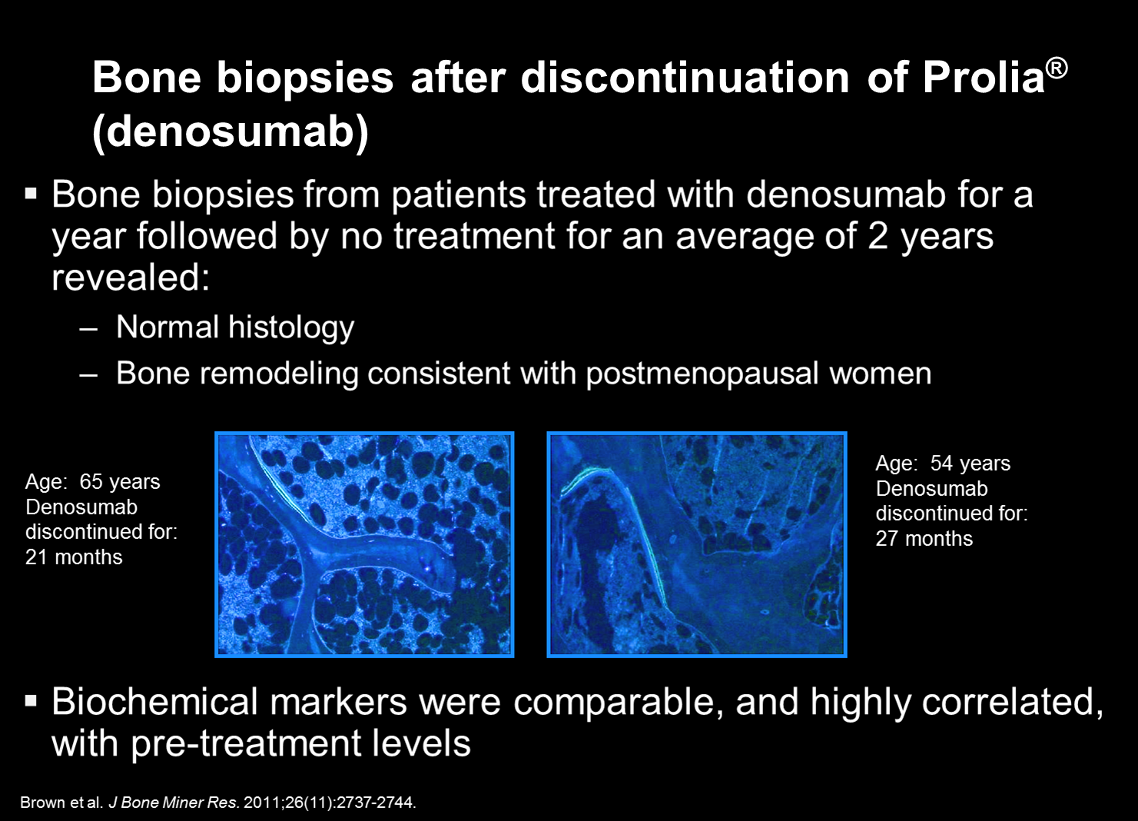
Bone Biopsies After Discontinuation of Denosumab
Bone biopsies from patients treated with denosumab for a year followed by no treatment for an average of 2 years revealed:
Normal histology
Bone remodeling consistent with postmenopausal women; similar to pretreatment level
Age: 65 years
Denosumab discontinued: for 21 months
Age: 54 years
Denosumab discontinued: for 27 months
Biochemical markers were comparable, and highly correlated with pre-treatment levels
Brown JP, et al. Bone Miner Res. 2011;26:2737-2744.
Notes:
The objective of this analysis is to characterize the effects of discontinuation of denosumab therapy on bone remodeling based on bone histology, bone histomorphometry , and biochemical markers of bone turnover in postmenopausal women with low bone mass or osteoporosis who were previously treated with denosumab.¹
Fifteen patients who had previously completed one of two 12-month clinical trials (10 from 179 study and 5 from Determining Efficacy: Comparison of Initiating Denosumab versus Alendronate [DECIDE]) who had no osteoporosis therapy for 12–36 months since trial completion were included. Within 34 days of enrollment, tetracycline cycles were administered twice followed by bone biopsy.¹
Patients enrolled in the 179 study received either denosumab 60 mg Q6M, alendronate 70 mg QW, or placebo.^{1,2}
Patients enrolled in the DECIDE study received either denosumab 60 mg Q6M or alendronate 70 mg QW. ^{1,3}
Brown JP, Dempster DW, Ding B, et al. Bone remodeling in postmenopausal women who discontinued denosumab treatment: off-treatment biopsy study. J Bone Miner Res. 2011;26:2737-2744.
Seeman E, Delmas PD, Hanley DA, et al. Microarchitectural deterioration of cortical and trabecular bone: differing effects of denosumab and alendronate. J Bone Miner Res. 2010;25:1886-1894.
Brown JP, Prince RL, Deal C, et al. Comparison of the effect of denosumab and alendronate on BMD and biochemical markers of bone turnover in postmenopausal women with low bone mass: a randomized, blinded, phase 3 trial. J Bone Miner Res. 2009;24:153-161.

Slide 64
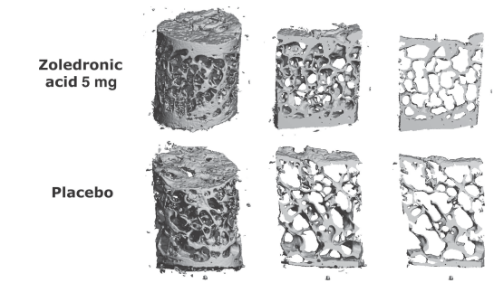
Bone Biopsies During Yearly Zoledronic Acid Treatment
Bone biopsies from postmenopausal women treated with zoledronic acid or placebo for 3 years (HORIZON Sub-study)
Annual dosing for 3 yrs with ZOL resulted in a median 63% reduction in bone turnover and preservation of bone structure and mass without any signs of adynamic bone.
Histomorphometry of representative biopsies obtained from one patient treated with ZOL 5 mg and placebo.
Recker RR, et al. J Bone Miner Res. 2008;23(1):6-16.
Notes:
bstract
In a substudy of the HORIZON pivotal fracture trial, in which yearly intravenous zoledronic acid 5 mg was found to significantly reduce risk of various fracture types in patients with postmenopausal osteoporosis, 152 patients underwent bone biopsy. Zoledronic acid reduced bone turnover by 63% and preserved bone structure and volume, with evidence of ongoing bone remodeling in 99% of biopsies obtained.
INTRODUCTION:
In the HORIZON pivotal fracture trial (PFT), enrolling 7,736 women with postmenopausal osteoporosis, three annual intravenous infusions of the bisphosphonate zoledronic acid (5 mg) significantly reduced morphometric vertebral, clinical vertebral, hip, and nonvertebral fractures by 70%, 77%, 41%, and 25%, respectively. Whereas 79% of patients received zoledronic acid/placebo only (stratum I, n = 6,113), 21% received concomitant treatment with other antiresorptive drugs, excluding other bisphosphonates, PTH, and strontium (stratum II, n = 1,652).
MATERIALS AND METHODS:
To determine effects on bone remodeling and bone architecture, iliac crest bone biopsies were obtained in 152 patients on active treatment or placebo at 3 yr after double tetracycline labeling. In five patients, only qualitative histology was performed, leaving 147 biopsy cores (79 on active treatment and 68 on placebo) for microCT analysis and histomorphometry.
RESULTS:
Analysis of bone structure by microCT revealed higher trabecular bone volume (BV/TV) in the zoledronic acid group (median, 16.6% versus 12.8%; p = 0.020). In addition, patients treated with zoledronic acid exhibited higher trabecular numbers (p = 0.008), decreased trabecular separation (p = 0.011), and a trend toward improvement in connectivity density (p = 0.062), all indicating better preservation of trabecular structure after treatment with zoledronic acid. Qualitative analysis revealed presence of tetracycline label in 81 of 82 biopsies from patients on zoledronic acid and all 70 biopsies from placebo patients, indicative of continued bone remodeling. No bone pathology was observed. Zoledronic acid induced a 63% median (71% mean) reduction of the activation frequency (Ac.f; p < 0.0001) and reduced mineralizing surface (MS/BS; p < 0.0001) and volume referent bone formation rate (BFR/BV) versus placebo, indicating reduced bone turnover. Mineral appositional rate was higher in the zoledronic acid group (p = 0.0002), suggesting improved osteoblast function compared with placebo. Mineralization lag time was similar in the two groups, whereas osteoid volume (OV/BV; p < 0.0001) and osteoid thickness (O.Th; p = 0.0094) were lower in zoledronic acid-treated patients, indicating normal osteoid formation and mineralization of newly formed bone. Concomitant administration of other antiresorptive osteoporosis therapies (e.g., raloxifene, tamoxifen, tibolone, ipriflavone) did not significantly alter the tissue level response to zoledronic acid.
CONCLUSIONS:
Annual dosing for 3 yr with zoledronic acid 5 mg intravenously resulted in a median 63% (mean, 71%) reduction of bone turnover and preservation of bone structure and mass without any signs of adynamic bone. Concomitant treatment with other osteoporosis therapies did not significantly affect the bone response to zoledronic acid.

Slide 65
There is Little Evidence to Support Any Recommendation Regarding Duration of Therapy or the Use of Drug Holidays¹
Benefits Outweigh
the Risks
Individualize Treatment
Drug Holiday Safe?
Perceived Danger
While some evidence suggests a drug holiday may be safe, in some cases the holiday was too long and resulted in significant increases in vertebral fracture risk^{2,3}
The concept of the need for an osteoporosis medication holiday reinforces a perception that these drugs are dangerous to use⁴
Benefits of continuing osteoporosis therapy in patients at risk of fracture exceeds the risk of rare adverse events early in treatment⁴
Treatment decisions should be based on an individual patient’s fracture risk⁴
Papaioannou, A., et al. CMAJ. 2010;182:1864-1873.;
Black, D.M., et al. J Bone Miner Res. 2012;27:243-54.;
Brown, J.P., et al. Can Fam Physician. 2014;60:325-333.;
Silverman, S.L., et al. Osteoporos Int. 2016;27:849-852.

Slide 66
Long-Term Therapy Remains Effective With long-term treatment BMD is maintained^{1,3} or continues to increase⁴
 | Antiresorptive Therapy |  |  |  | Bone Formation Therapy
 | Bisphosphonates |  |  | Denosumab^{4†} (N=1 343) | Teriparatide⁵ (N=107)
 | Oral Branded¹ | Oral Generic² | IV³ (N=92)
Pivotal Study Extension | VERT-MN | FLEX | HORIZON | FREEDOM
Treatment Duration (yrs) | 7 | 10 | 9 | 10 | 1.5
% Change Lumbar Spine BMD ^{Ŧ} | 11.5 | 3.61 | NR | 21.7 | 6.69
% Change Total Hip BMD^{Ŧ} | 3.9 | 2.57 | 4.6 | 9.2 | NR
Hip Fracture Incidence (%) | ‡Not measured |  | NR | <0.1 | <1.0
*Not head-to-head analyses: Results cannot be compared due to differing study populations and methodologies; Ŧ Represents % change from BL of Pivotal Trial; ‡ Studies measured non-vertebral fracture incidence which included hip fractures. Non-vertebral fracture incidence: RIS 6.0%; †Interim Analyses of 10 year FREEDOM extension study.
1. Mellstrom, D., et al. Calcif Tissue Int. 2004;75:462-468.; 2. Black, D.M., et al. JAMA. 2006;296(24):2927-2938.; 3. Black, D.M., et al. J Bone Miner Res. 2014;30(5):934-44. DOI: 10.1002/jbmr.2442; 4. Bone, H.G., et al. Lancet Diabetes Endocrinol. 2017;5(7):513-523; 5. Tanaka, S., et al. Curr Med Res Opin. 2014;30(5):931-6.
Notes:
Key Points:
This slide shows lumbar spine and total hip BMD values from long-term trials of antiresorptive therapies, where BMD continues to increase or remains stable over time
NB: Not head-to-head comparisons; results cannot be compared across trials due to different populations and methods
References:
Mellstrom, D., et al. (2004). Calcif Tissue Int., 75:462-468.
Black, D.M., et al. (2006). JAMA, 296(24):2927-2938.
Black, D.M., et al. (2014). J Bone Miner Res., 30(5):934-44. DOI: 10.1002/jbmr.2442.
Papapoulos, S., (2013). ASBMR., Abstract LB-MO26.
ESCEO Conference, 2015, Oral Presentation: OC4.
Tanaka, S., et al. (2014). Curr Med Res Opin., 30(5):931-6.

Slide 67
Long-Term Use of BP Prevented Bone Loss and Reduced Vertebral Fractures
Long-term BP therapy (ALN 10 years, ZOL 6 years) prevented bone loss at multiple skeletal sites and a reduction in vertebral fractures compared with stopping ALN after 5 years or ZOL after 3 years
Greatest benefit over long-term ALN or ZOL therapy were patients categorized as:
High risk (persistent low T-score at hip (≤2.5 for total hip or femoral neck T-score (HORIZON) and > –2.5 but ≤ 2 for femoral neck (FLEX))
Had incident fracture during the core study
Prevalent vertebral fracture (at entrance to HORIZON extension)
Continued ALN resulted in a lower risk of clinical vertebral fractures, whereas ZOL resulted in a lower risk of morphometric vertebral fractures
Adler RA, et al. J Bone Miner Res. 2016;31(1):16-35.

Slide 68
Treating High Risk Patient: Long-Term
There is no arbitrary time limit to osteoporosis therapy¹
In high risk patients, switching therapy from bisphosphonate to non-bisphosphonate antiresorptive or anabolic therapy may be rational¹
No drug holiday for HRT, SERMs, teriparatide and denosumab^{1,2}
Drug holiday (not retirement) is feasible with ALN, RIS and ZOL after 3-5 years if patient at moderate risk³
If bisphosphonate interrupted, reassess risk (and BMD) after:^{2,3}
1 yr for risedronate, 2 yrs for alendronate, 3 yrs for zoledronic acid
Long-term adverse effects of osteoporosis therapies are offset in high risk patients by the benefits of long-term reduction in fractures^{1,3}
HRT: hormone replacement therapy; SERMs: selective estrogen receptor modulators.
1. Papaioannou, A., et al. CMAJ. 2010;182:1864-1873.; 2. Silverman, S.L., et al. Osteoporos Int. 2016;27:849-852.; 3. Brown, J.P., et al. Can Fam Physician. 2014;60:325-333.

Slide 69
Safety of Osteoporosis Therapy
 | Antiresorptive Therapy |  |  | Bone Formation Therapy
 | Bisphosphonates |  | Denosumab^{3†} (8 yrs exposure) | Teriparatide ⁴ (up to 2 yrs exposure)
 | Risedronate¹ (2 yrs exposure) | Zoledronic acid² (3 yrs exposure)
Serious AEs | Distribution of severe adverse events was similar across treatment groups. Actonel vs placebo | 29.2% zoledronic acid vs 30.1% placebo | 25.8% denosumab vs 25.1% placebo Denosumab: n=1004 Placebo: n= 972
AEs leading to treatment discontinuation | 5.5% Risedronate vs 6.0% placebo | 2.1% zoledronic acid vs 1.8% placebo | 4.9% denosumab vs 5.2% placebo Denosumab: n=192 Placebo: n= 202 | 7.1% Teriparatide vs 5.6% placebo
Rate of Specific AEs | GI adverse events 38.8% Actonel DR vs 34.9% Actonel Abdominal pain, vomiting, and upper abdominal pain: rate with ACTONEL DR (6.2%, 4.9%, 3.6%) vs ACTONEL 5mg (3.3%, 3.3%, 2.6%) | Atrial fibrillation 1.3% zoledronic acid vs 0.6% placebo | Osteoarthritis, atrial fibrillation and pneumonia: rate with denosumab (1.6%, 0.9%, 0.9%) vs placebo (2.0%, 0.9%, 0.9%) | Dizziness, nausea, arthralgia, asthenia and headache: rate with teriparatide (8.0%, 8.5%, 10.1%, 8.7%, 7.5%) vs placebo (5.4%, 6.7%, 8.4%, 6.8%, 7.4%)
†Exposure-adjusted subject incidences of AEs (Rates per 100 subject-years).
1. Actonel ® /Actonel DRTM ® Product Monograph. Allergan Pharma Co. Aug. 3, 2017; 2. Aclasta® Product Monograph. Novartis Pharmaceuticals Canada Inc. April 10, 2017; 3. Prolia® Product Monograph. Amgen Canada Inc. June 20, 2016; 4. Forteo® (teriparatide injection) Product Monograph. Eli Lilly Canada Inc. Feb 9, 2010.

Slide 70
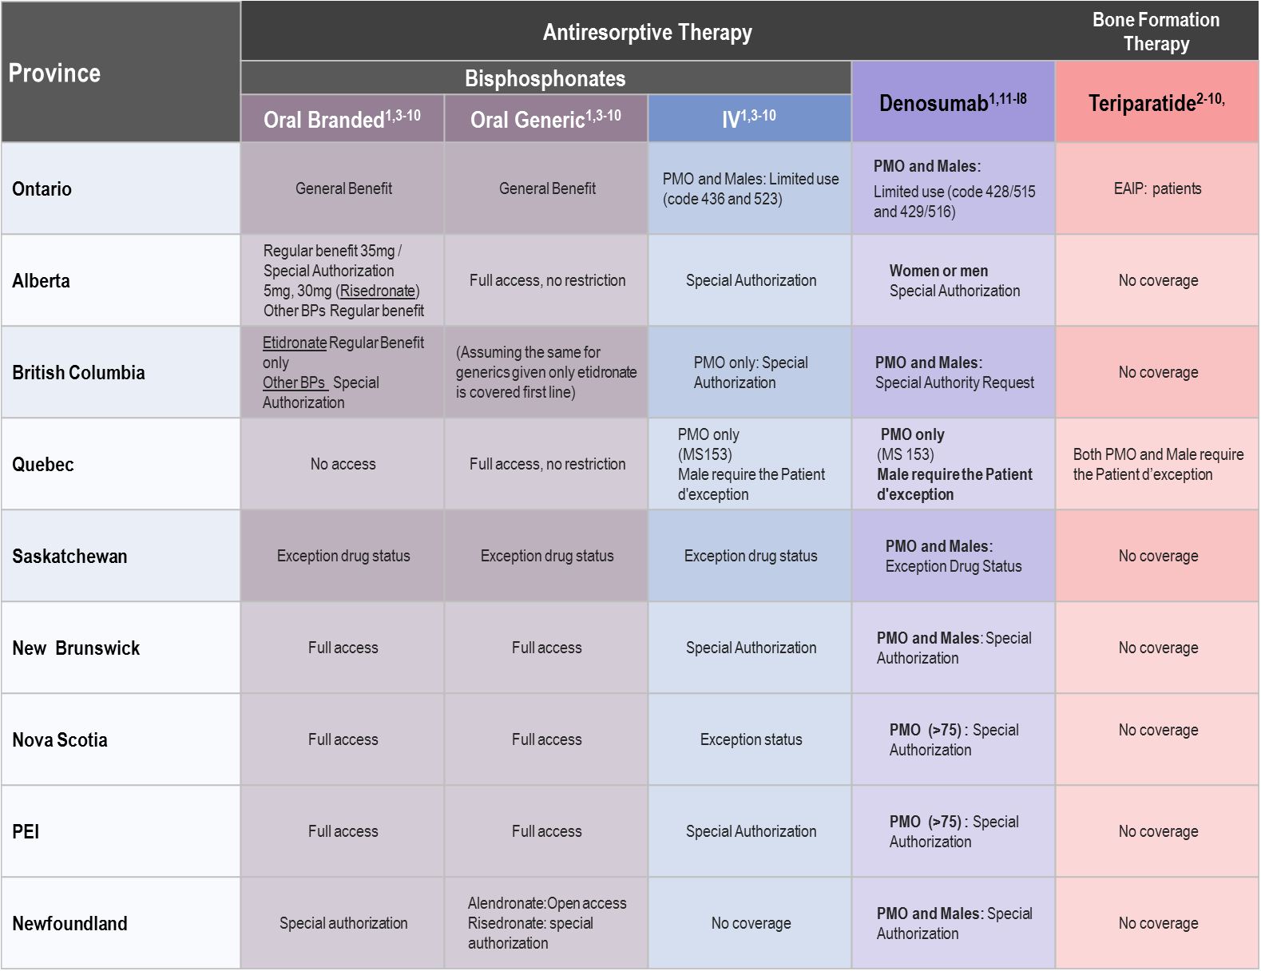
Reimbursement
Notes:
References:
Ontario Drug Benefit Formulary/Comparative Drug Index Edition 43. Accessed February 7, 2018. http://www.health.gov.on.ca/en/pro/ programs/drugs/formulary43/summary_edition43_20180124.pdf.
Ministry of Health and Long-term Care Exceptional Access Program (EAP). September 2017. Accessed April 26, 2018. http://www.health.gov.on.ca/en/pro/programs/drugs/pdf/frequently_requested_drugs.pdf.
Alberta Health Services Interactive Drug Benefit List. Accessed April 26, 2018. https://idbl.ab.bluecross.ca/idbl/search.do
BC Pharmacare Limited Coverage Drugs Program. Accessed April 24, 2018. https://www2.gov.bc.ca/gov/content/health/practitioner-professional-resources/pharmacare/prescribers/limited-coverage-drug-program/limited-coverage-drugs-denosumab
Régie de l’assurance maladie Québec. Liste de médicaments – Établissements – Modification no1 et Correction no1, 32e édition, entrant en vigueur en juillet 2011. Accessed February 3, 2012. http://www.ramq.gouv.qc.ca/fr/professionnels/medicaments/demande_medicament_exception_mc.shtml.
Government of Saskatchewan Exception Drug Status Program. Accessed April 27, 2018.http://formulary.drugplan.ehealthsask.ca/PDFs/APPENDIXA.pdf
Nova Scotia Pharmacare Formulary April 2018. Accessed April 27, 2018. https://novascotia.ca/dhw/pharmacare/documents/formulary.pdf
Newfoundland Labrador Health and Community Services NLPDP Drug Product Database. Accessed April 27,2018. http://www.health.gov.nl.ca/health/prescription/newformulary.asp
New Brunswick Drug Plans Formulary. Accessed April 27, 2018. http://www2.gnb.ca/content/dam/gnb/Departments/h-s/pdf/en/NBDrugPlan/NewBrunswickDrugPlansFormulary.pdf
PEI Pharmacare Formulary. Accessed April 27, 2018. https://www.princeedwardisland.ca/sites/default/files/publications/pei_pharmacare_formulary.pdf
Government of Alberta Health and Wellness. Updates to the Alberta Health and Wellness Drug Benefit List, February 1, 2016. Accessed February 26, 2016. http://www.ab.bluecross.ca/dbl/pdfs/dbl_oct.pdf.
Ministry of Health Services. Confirmation of Prolia (denosumab) as eligible Limited Coverage benefit under British Columbia PharmaCare program [Letter]. December 23, 2011.
Saskatchewan Formulary Bulletin #168, January 1, 2018. Accessed February 7, 2018. http://formulary.drugplan.ehealthsask.ca/Bulletins/ Bulletin168Jan2018.pdf.
New Brunswick Drug Plans Formulary Bulletin #965, January 22, 2018. Accessed February 7, 2018. http://www2.gnb.ca/content/dam/gnb/Departments/h-s/pdf/en/NBDrugPlan/FormularyUpdates/NBDrugPlansBulletin965.pdf.
Government of Nova Scotia Health and Wellness. Pharmacare Drug Information. Accessed August 18, 2011. http://www.gov.ns.ca/health/ pharmacare/details.asp?din=02343541&scs=M05BX04&format=syringe&searchfie.
Government of Newfoundland and Labrador. Department of Health and Community Services. Special Authorization Drug Products. Accessed August 22, 2011. http://www.health.gov.nl.ca/health/nlpdp/sadsearch.asp.
Health PEI: P.E.I. Pharmacare Formulary. Accessed March 13, 2014. http://www.gov.pe.ca/photos/original/hpei_formulary.pdf.
Prolia Product Monograph. Amgen Canada Inc., February 13, 2018.

Slide 71

Discussion: Clinical Takeaways
Case finding: We need to be holistic in our approach to osteoporosis and identifying those are risk. Hx review, fracture hx, other medications, risk of falling, overview of our understanding of our patient and the potential issues of follow up, adherence and fitness are all important factors in understanding the specific risk and the options for treatment.
BMD is a measure of bone density, not bone quality: So the need to review the entire picture is paramount as we understand the impact of the data, both from CaMOS and from Dr. Siris, and the need to be focused on fracture risk, not merely BMD.
OP risk factors: Including the new information on medications and other diseases, such as Parkinson’s, MS etc., all speak to the need for family medicine to be in the forefront of case finding and reviewing our patient population. Aim is to avoid long-term care, chronic disability and loss of independence, keeping our older population active and in the community. It is in our hands.
Notes:
Key Point:

Slide 72
Discussion: Clinical Takeaways
All adult patients initiated with long-term glucocorticoids (prednisone > 7.5 mg / d for > 3 months should be rapidly [< 3 months]):
Assessed for bone health (DXA ± Lateral Spine X-Rays, lab. tests)
Initiated on antiresorptive treatment with Ca/vitamin D
Monitored annually (DXA ± Lateral Spine X-Rays, lab. tests)
The Cancer Treatment Induced Bone Loss (CTIBL) associated with Aromatase Inhibitors (AIs) could be prevented by bisphosphonates or denosumab and the skeletal related events reduced further by denosumab compared to bisphosphonates
All evaluated PMO therapies are improving bone mineral density in men receiving Androgen Deprivation Therapy (ADT) but denosumab is the only treatment option that also reduced the occurrence of new vertebral fracture in that population
Notes:
Key Point:

Slide 73
Discussion: Clinical Takeaways
Men are at high fracture risk, similar to women with the same risk factors but later in life but men have a higher mortality risk than women after hip fracture
Treatment for men is the same than women
Persistence with osteoporosis therapy is associated with superior anti-fracture efficacy
Persistence may be related to preference for long interval therapy into greater effectiveness of parenteral antiresorptive as compared to oral bisphosphonate
Longer-term therapy with denosumab is associated with greater non-vertebral fracture efficacy
Osteoporosis therapies are well tolerated over the longer-term and patients at risk must continue on osteoporosis treatment
Patients on denosumab must not stop therapy but might switch to bisphosphonate first if a bisphosphonate drug interruption may be required in the future
Notes:
Key Point:

Slide 74
Discussion: Clinical Takeaways
Prior fractures are more important in determining fracture risk than an osteopenic BMD
Neurologic lesions leading to falls have a major impact on fracture risk that is not captured by FRAX or CAROC
Patient preference should always be considered when determining treatment. In this instance switching from a weekly to every 6 month treatment.
Drug holidays should not be considered in any high risk individuals
Notes:
Key Point:

